Slide 1
Vernier Laser Modeling
Alex Sludds

Slide 2
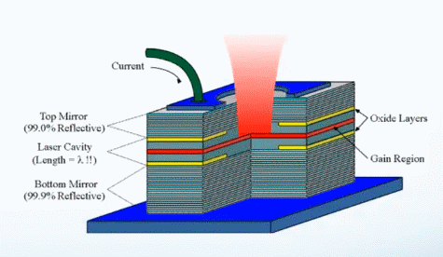
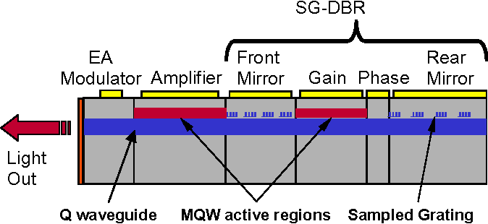
What’s inside of a laser?
Lasers are composed of:
A gain medium to generate + amplify light
A pump for the gain medium (electrical or optical)
A cavity to confine light, select what the output wavelength is, defined by a front and back mirror
Front mirror
Gain medium
Back mirror

Slide 3
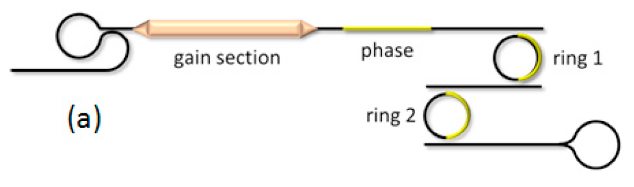
What’s inside of a tunable laser?
We want the ability to tune our lasers post-fab to get precise wavelength spacings.
Tunable lasers are composed of:
A gain medium to generate + amplify light
A pump for the gain medium
A longitudinal cavity defined by front and back mirrors, allows for multiple passes through the gain medium
A tunable filter, often in a Vernier configuration, to select for the output wavelength
Front mirror
Back mirror
Longitudinal mode phase shifter
Tunable Filter
* From “Widely-Tunable Ring-Resonator Semiconductor Lasers”, Bowers

Slide 4
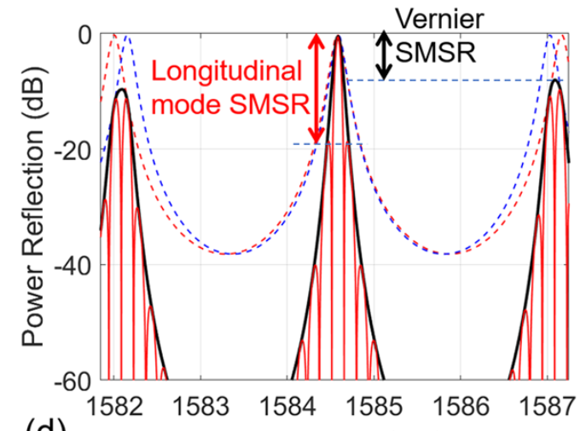
Design concerns + constraints for us building a tunable laser
Some special care must be taken when we design a tunable laser to make sure:
It does not mode-hop
The Vernier filter has sufficient side-mode suppression ratio (SMSR) of both neighboring Vernier modes as well as longitudinal cavity modes. Both contribute to laser SMSR.
Internal cavity losses from NLA are reduced + well modeled
Lower output power
Worse linewidth, phase noise
Less immune to reflections
Under the constraint that we reuse our IP on 45CLO as much as possible (keep it potato)
* From “Widely-Tunable Ring-Resonator Semiconductor Lasers”, Bowers
* From “Tutorial on narrow linewidth…”, Bowers

Slide 5
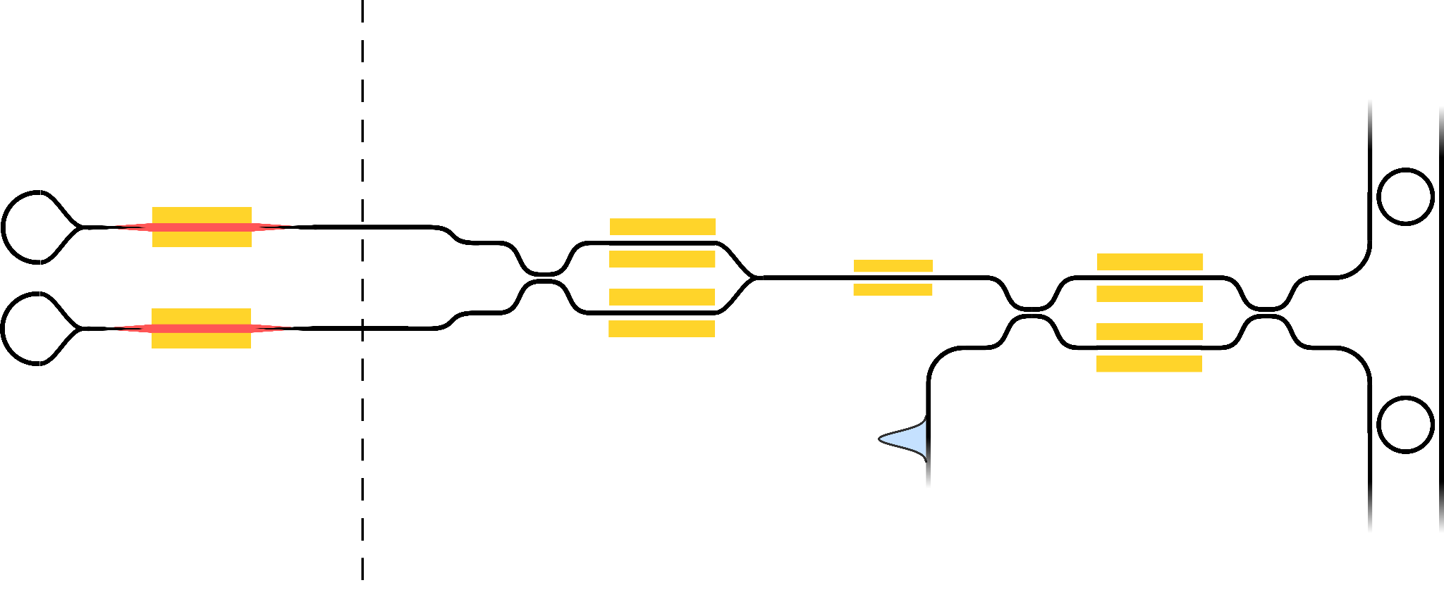
What will it look like, how do we model this?
The same fundamental idea, but with a few tweaks to improve output power.
Very critical to getting a power estimate will be having models of the SOA and models of NLA
To do this, I’ll be using the tools we have built up in Virtuoso to model photonic components
Tower + Openlight die
45CLO die
Model of an SOA
Model of NLA + NLA inside of rings
* From “Widely-Tunable Ring-Resonator Semiconductor Lasers”, Bowers

Slide 6
SOA Model in VerilogA

Slide 7
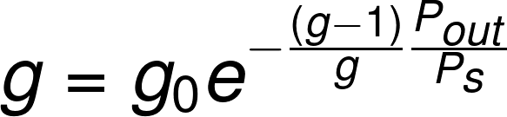
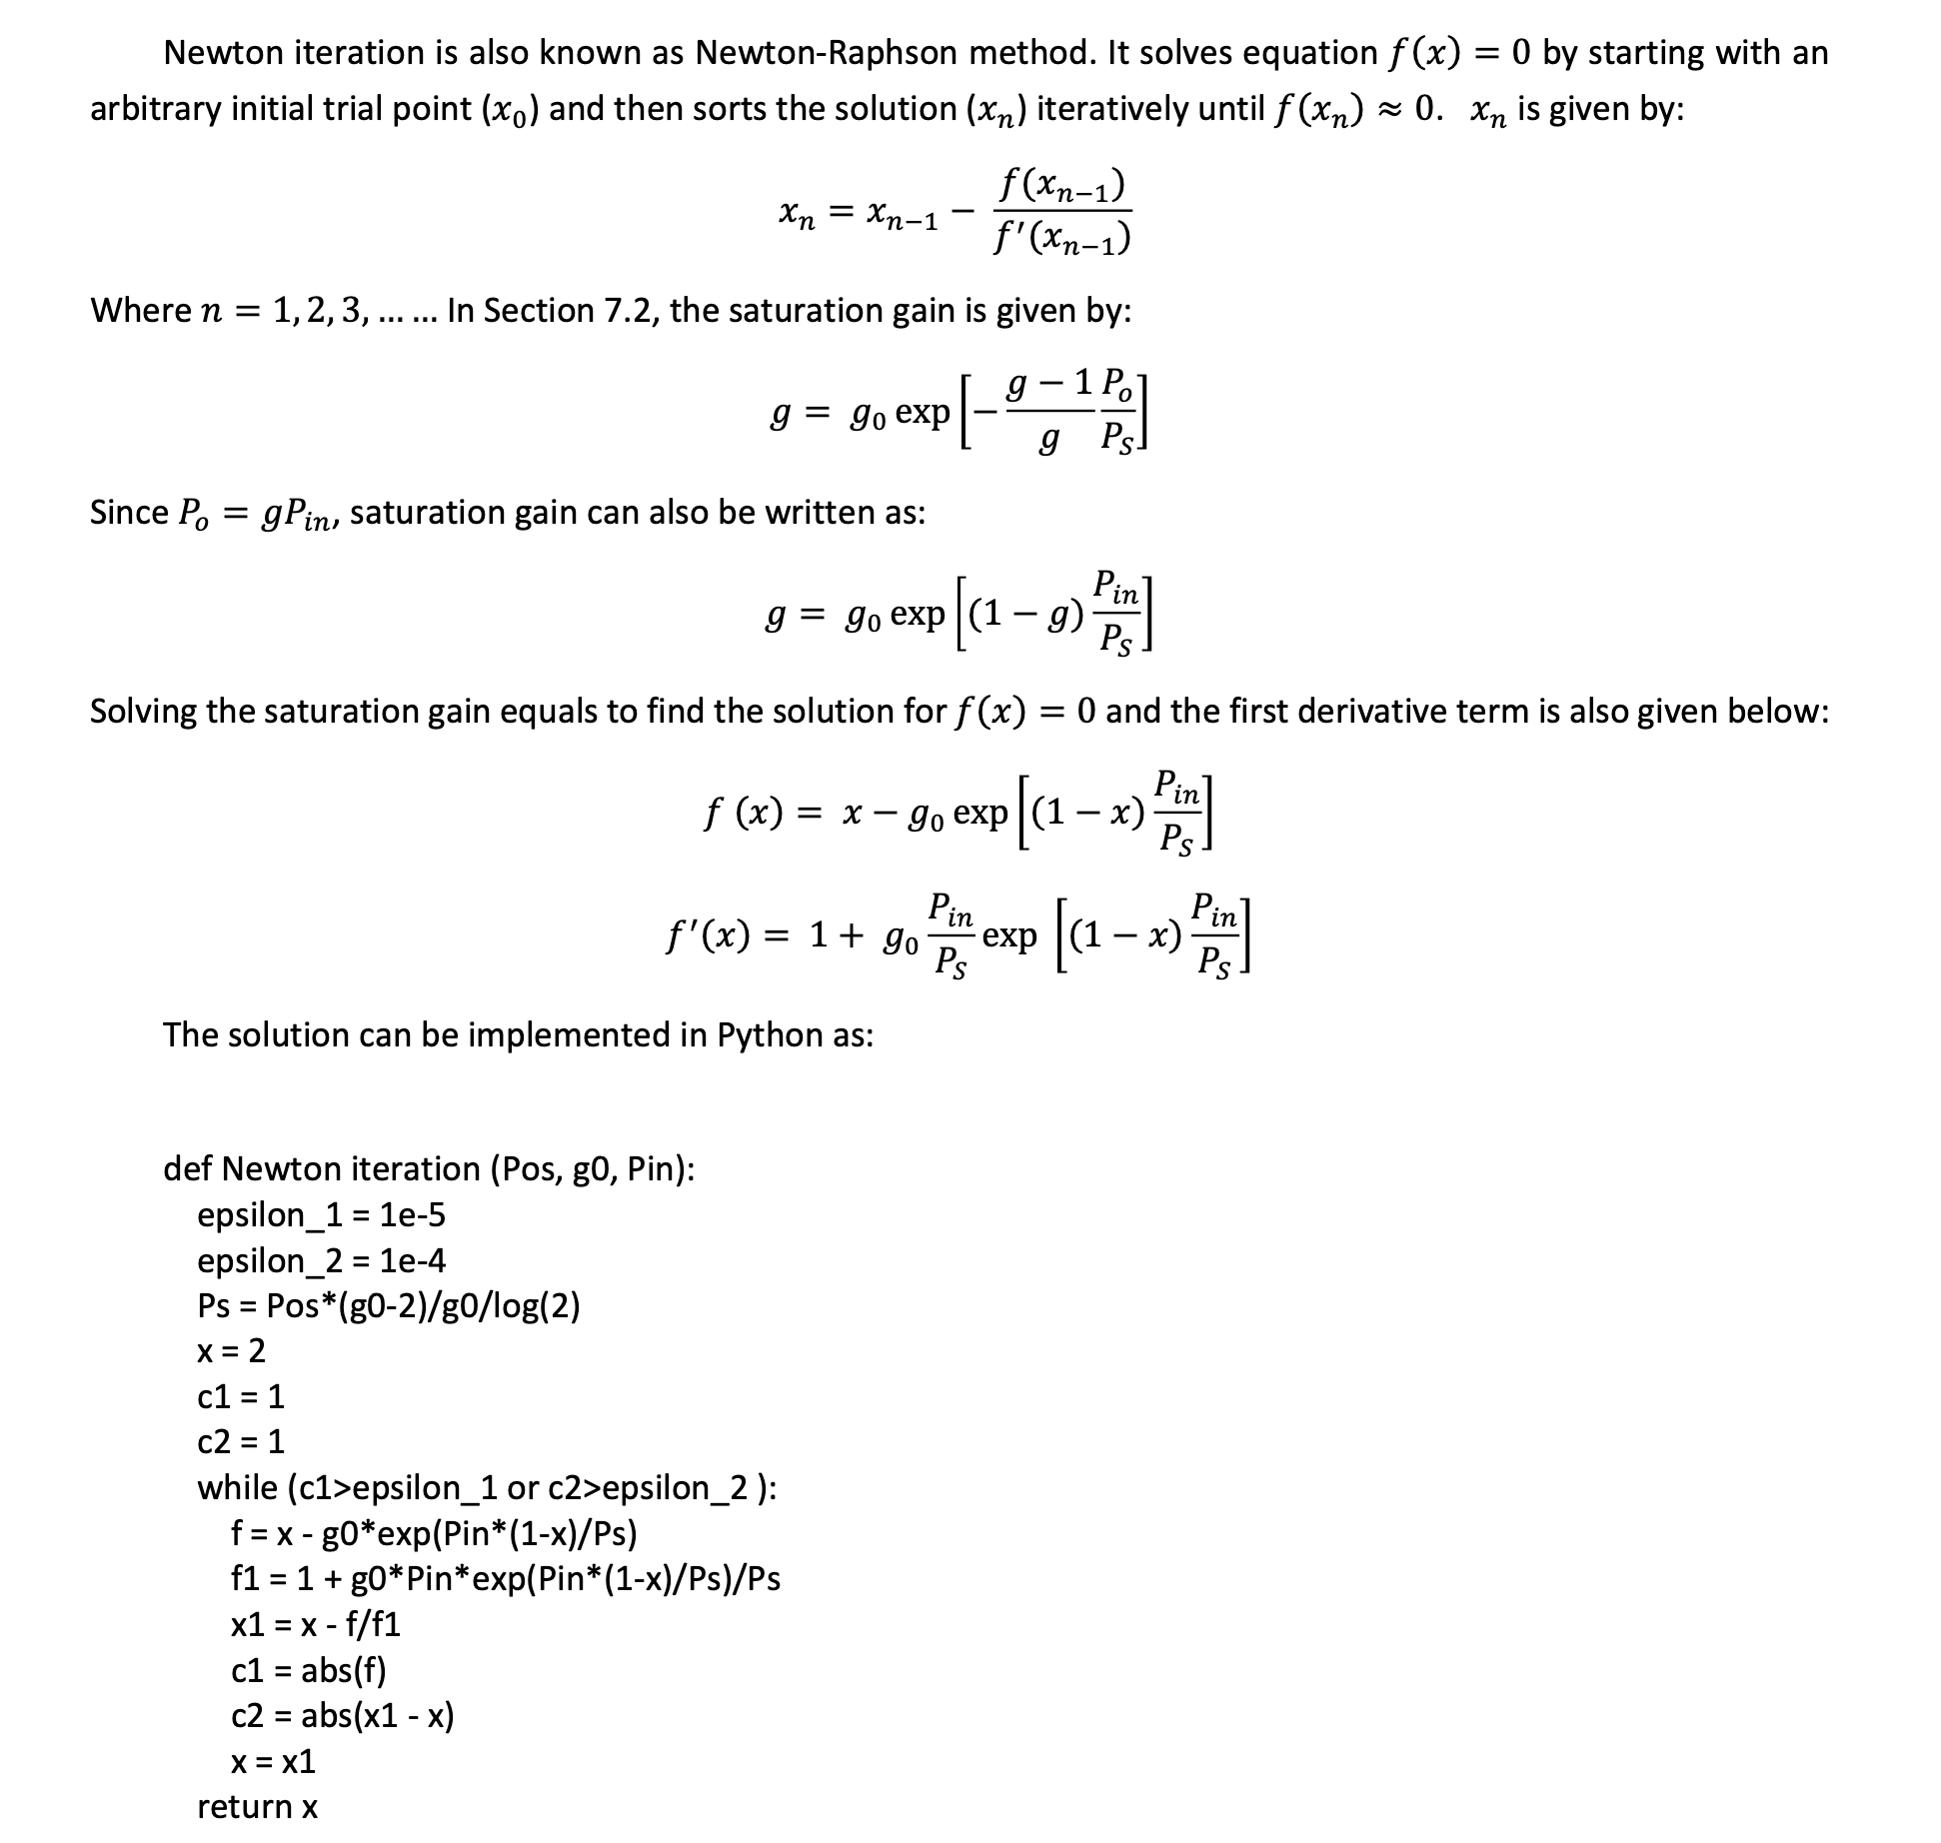
SOA Model
From Tower SOA document:
Use Newton method (taken from Tower SOA Application Note):
Notes:
g = g_{0}e^{-\frac{(g-1)}{g}\frac{P_{out}}{P_{s}}}
g = g_{0}e^{-(g-1)\frac{P_{in}}{P_{s}}}

Slide 8
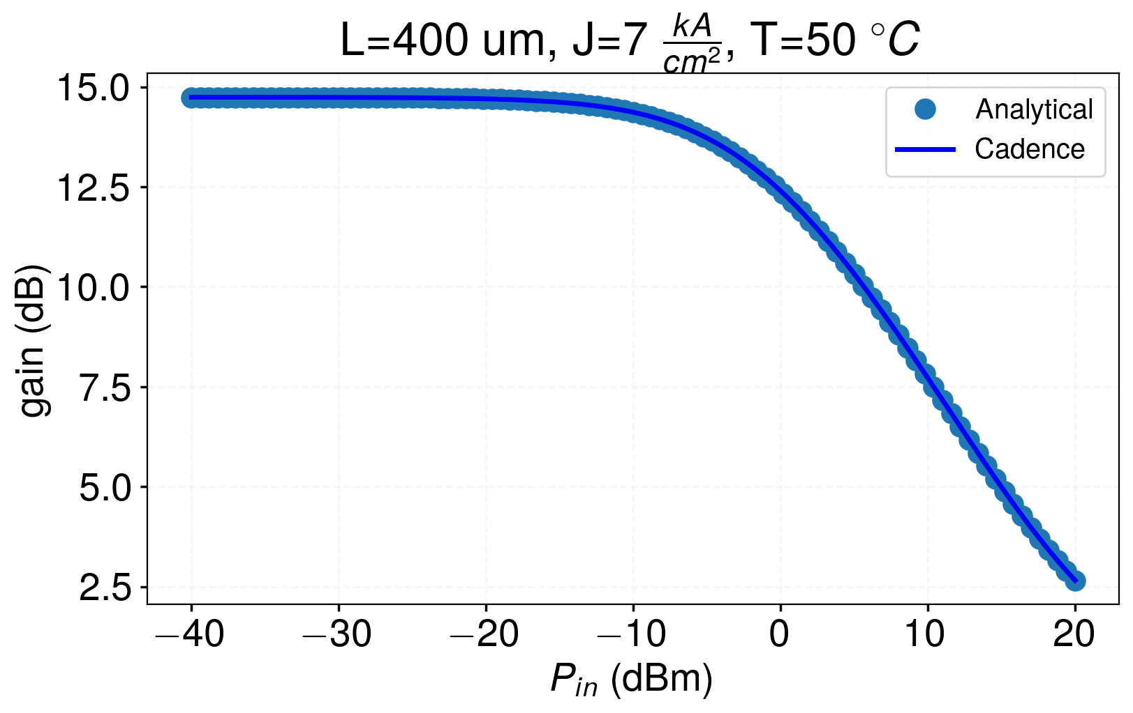
Gain vs Pin

Slide 9
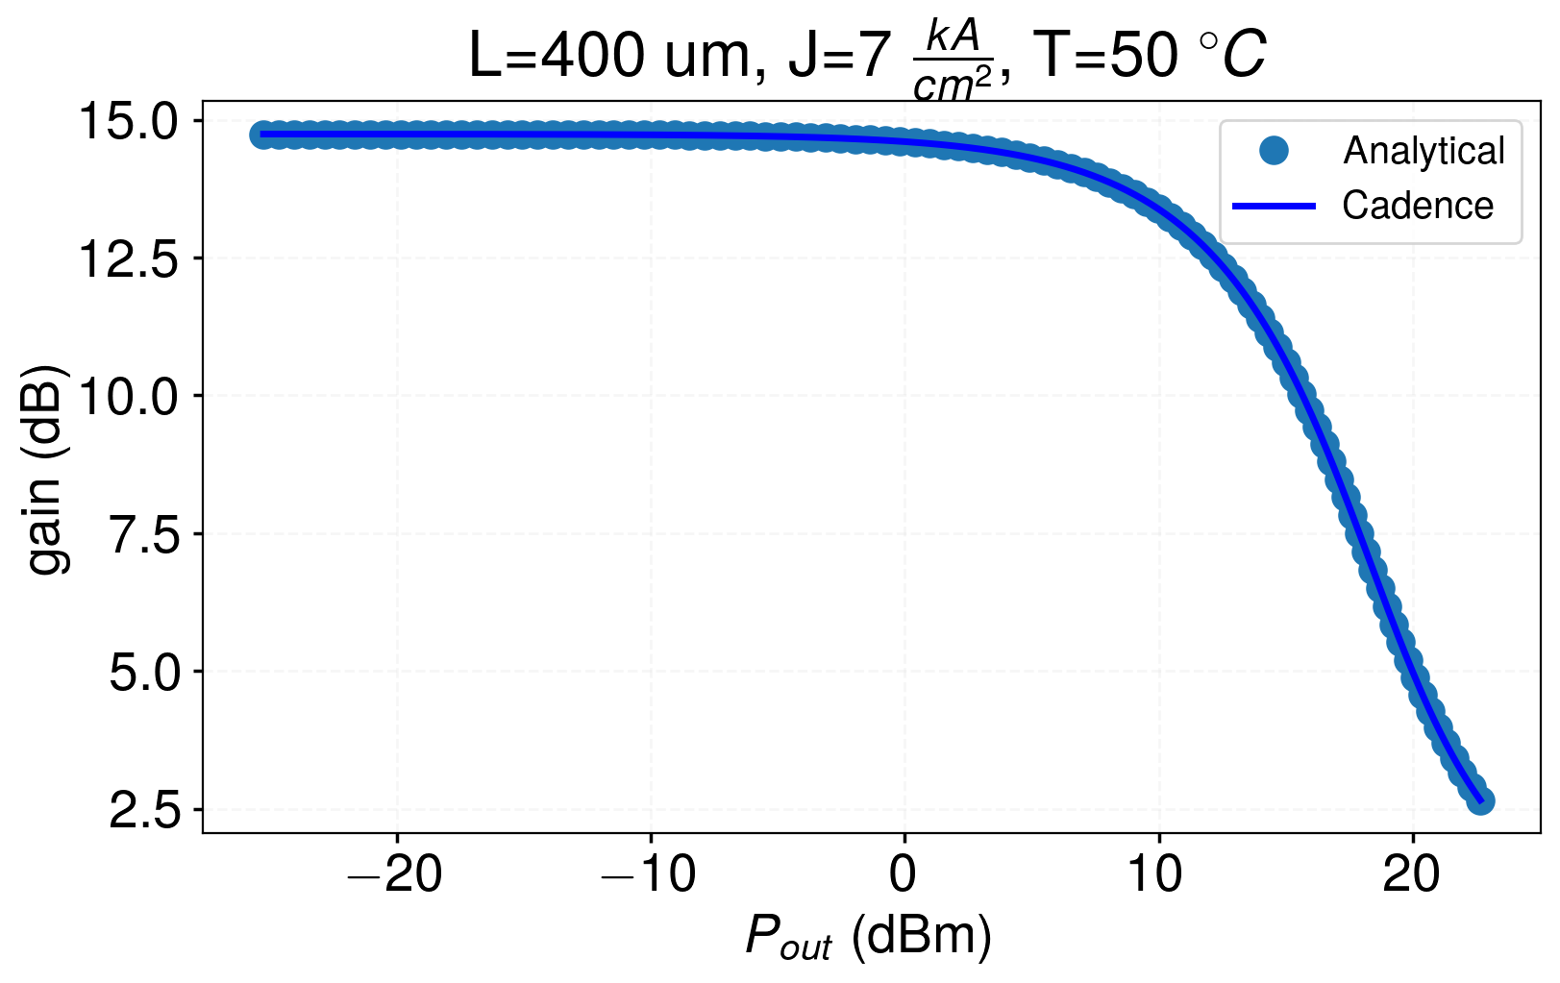
Gain vs Pout

Slide 10
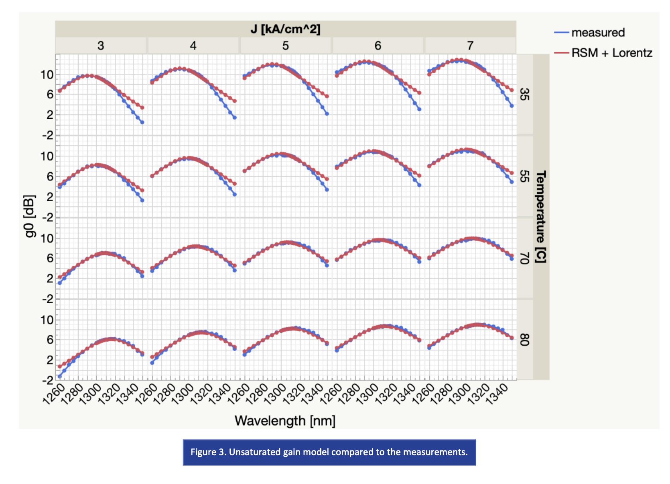
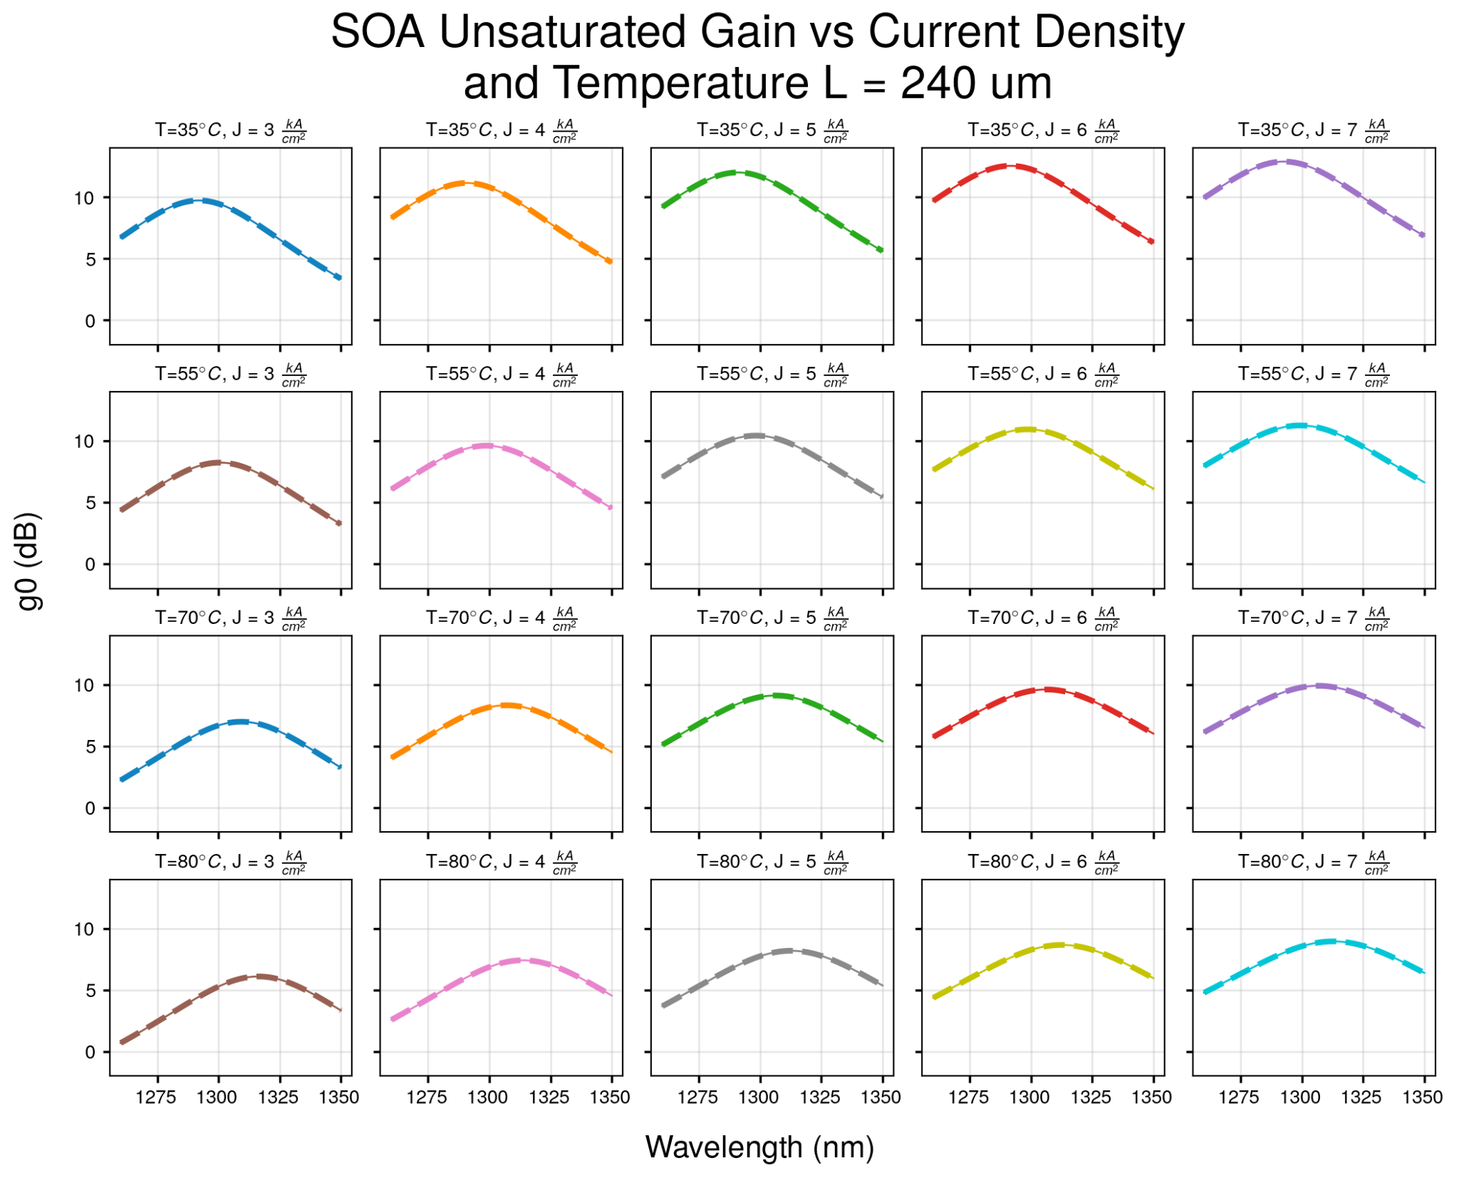

Slide 11
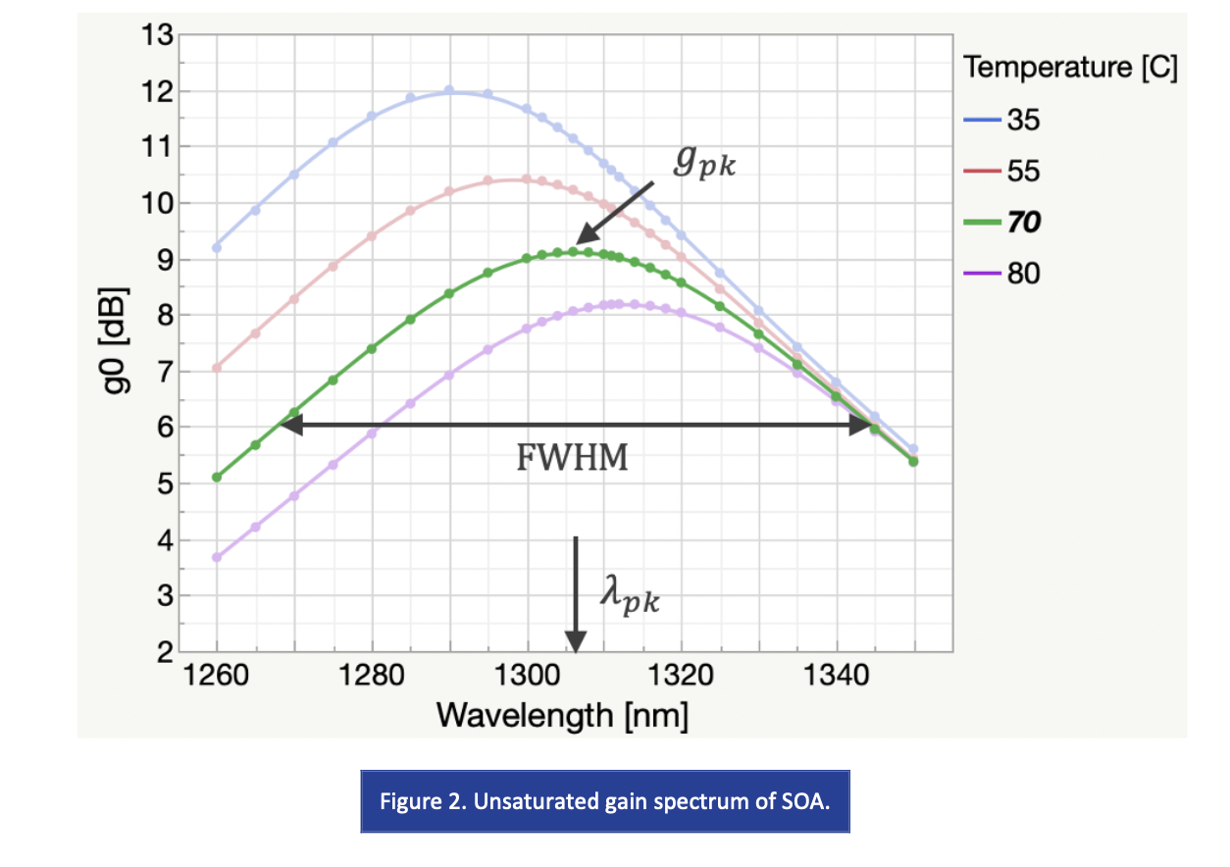
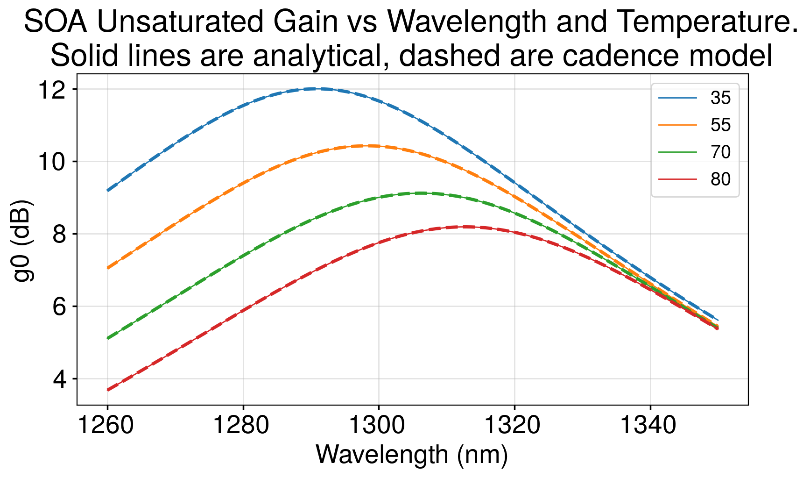

Slide 12
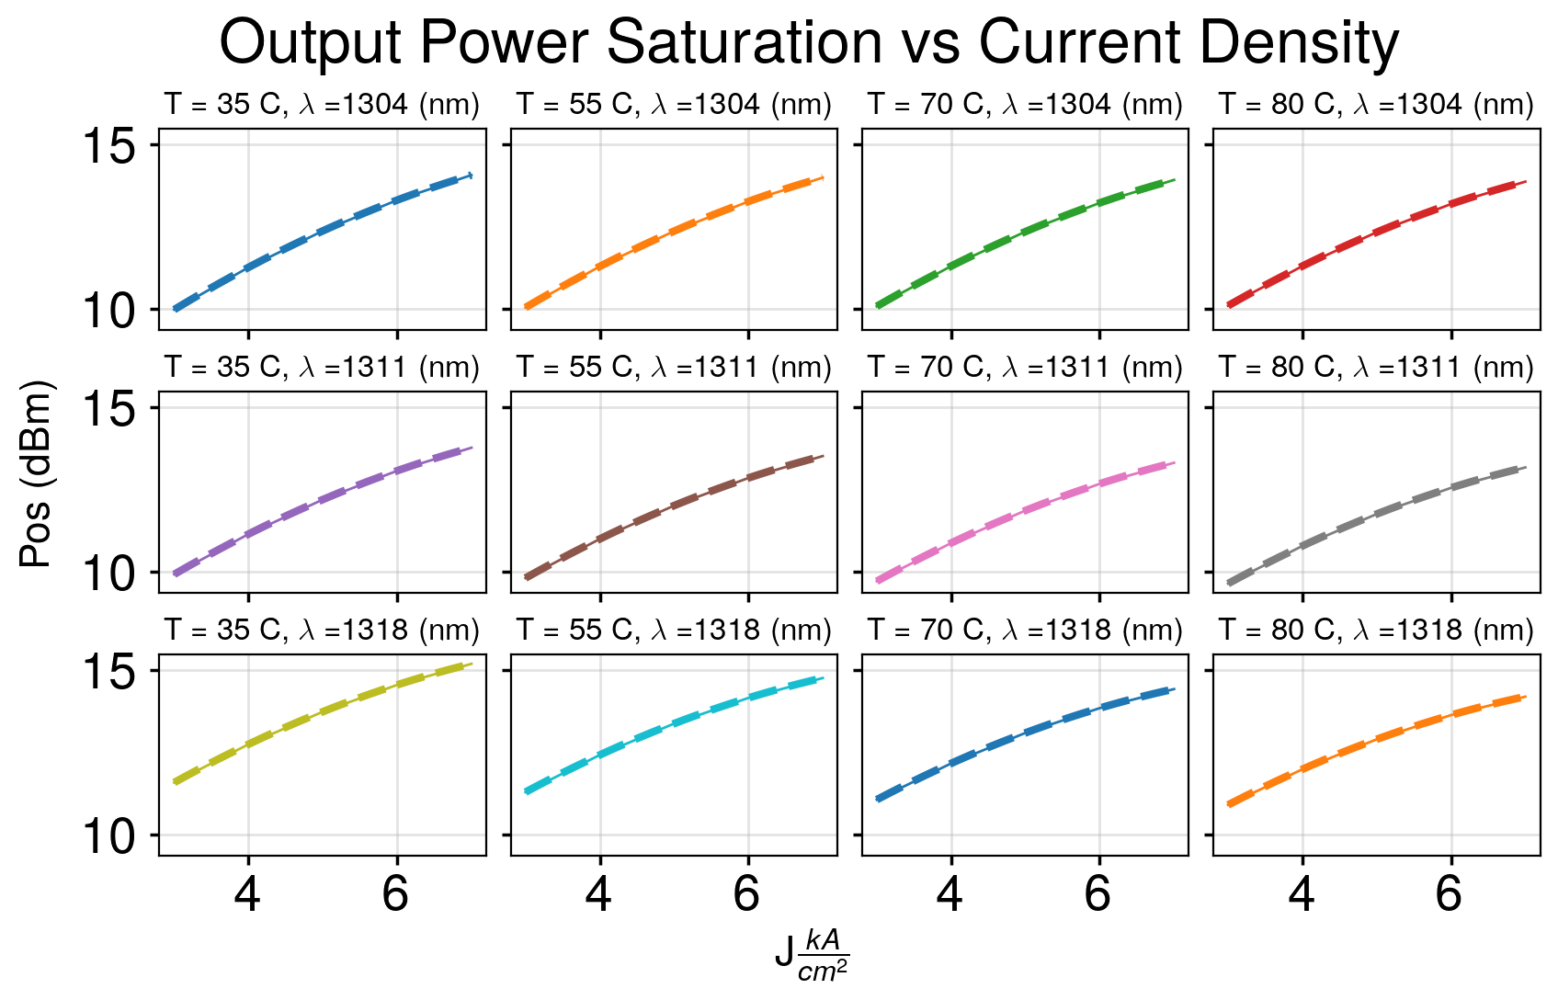

Slide 13
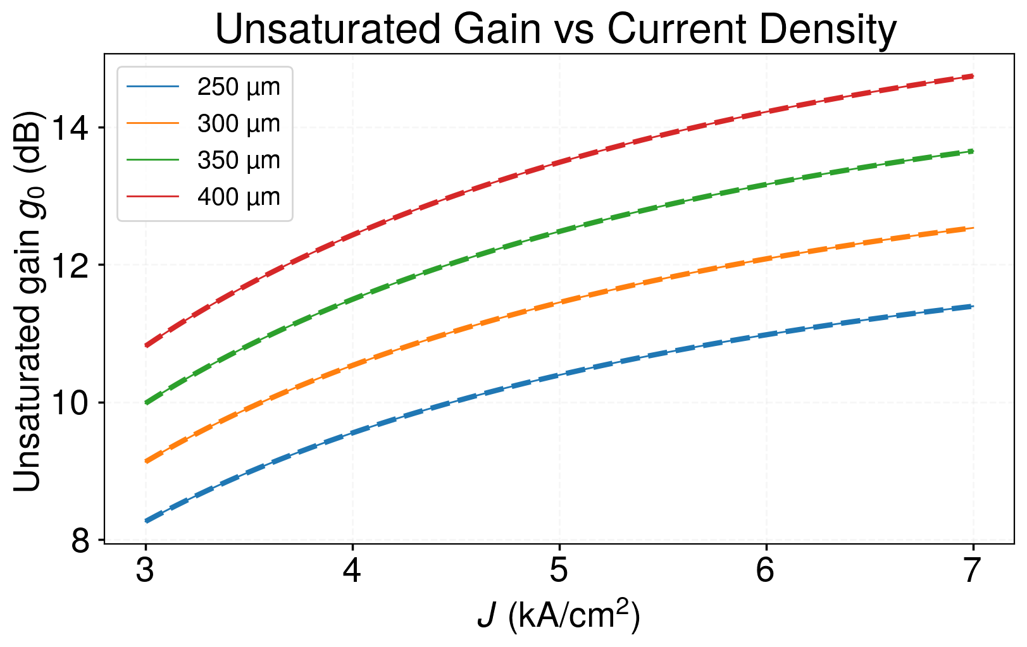

Slide 14
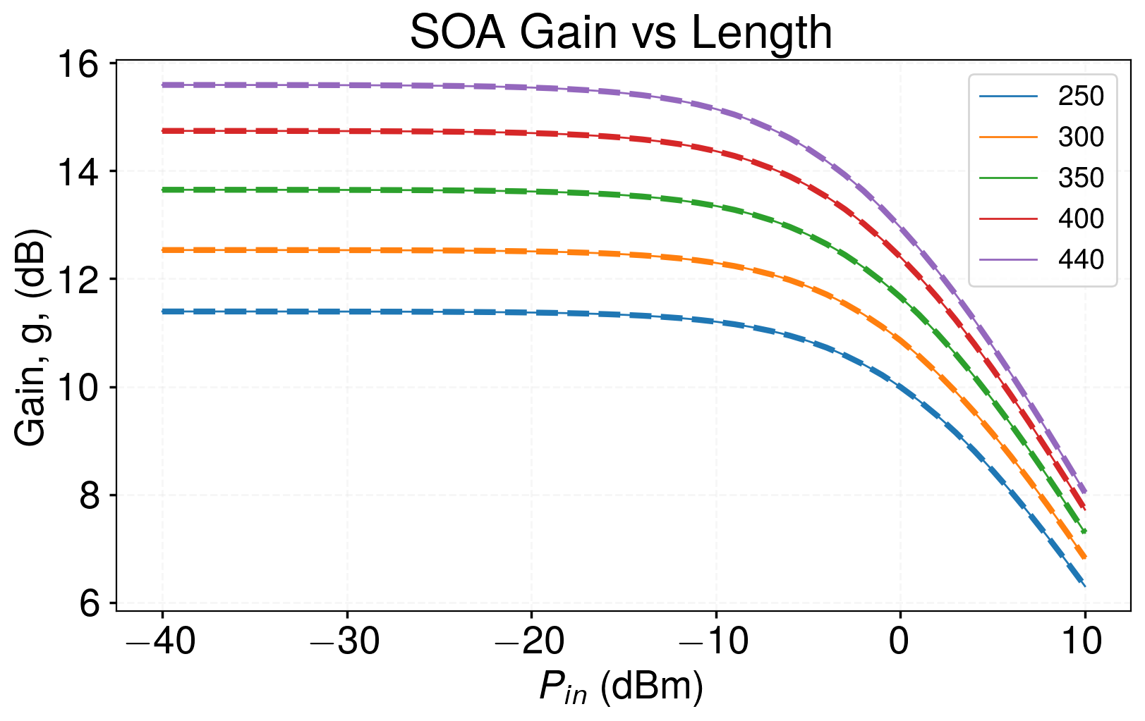

Slide 15
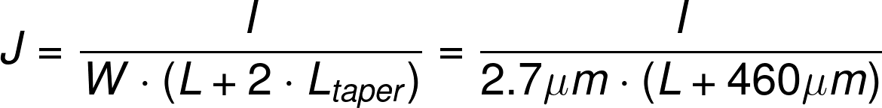
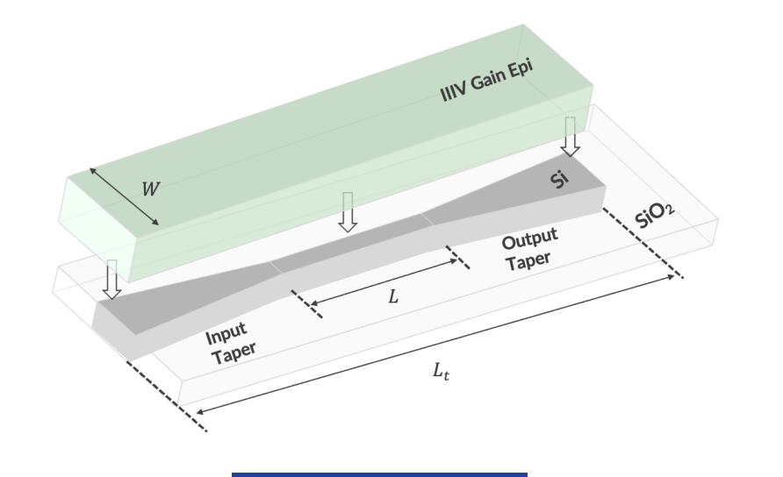
A note on converting from current density to current
In our SOA:
The SOA model is parameterized by openlight over J=[3kA/cm², 7kA/cm²]
For reference, I = 170 mA @ J=7kA/cm²,L=440um
P = 266mW
This desmos calculator plots J on the x-axis and calculates output current. L is a slider.
It also includes voltage, electrical power dissipation and wall-plug-efficiency estimates
Notes:
J = \frac{I}{W\cdot (L + 2\cdot L_{taper})} = \frac{I}{2.7\mu m \cdot (L + 460\mu m)}

Slide 16
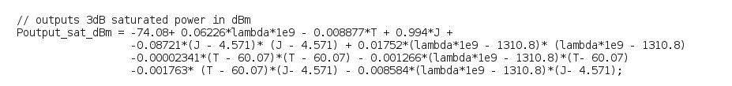
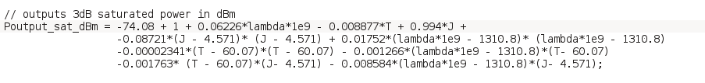
SOA Model Tweak Based on Openlight feedback
Openlight feedback: Set W=2.7um instead of W=2um, add 1dB to P_{sat}
https://docs.google.com/presentation/d/1IF7M-8-VXjMyahIuh5ue8TEhhMlgL0FB/edit#slide=id.p3
https://drive.google.com/file/d/1oG4sAcibSqhDvkvAENOENqYsTFVuaHim/view
Before:
After:

Slide 17
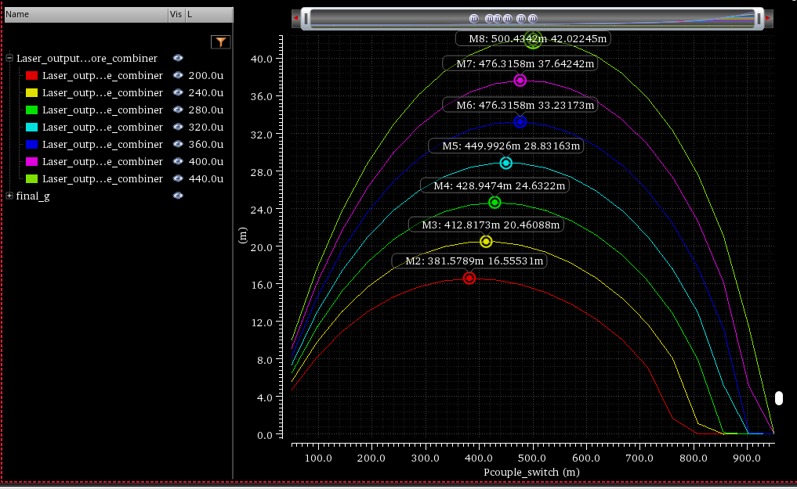
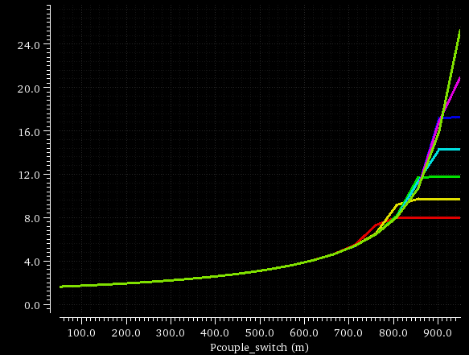
What SOA length do we use? (before openlight discussion)
Length (um) | Optimal output coupling | Laser output power (mW)
200um | 0.381 | 16.55
240um | 0.413 | 20.46
280um | 0.428 | 24.63
320um | 0.450 | 28.83
360um | 0.476 | 33.23
400um | 0.476 | 37.64
440um | 0.501 | 42.02
Take SiN Vernier mirror laser with the following specs:
Radius1 = 40u
Radius2 = 1.05 * Radius1 = 42u
Temperature = 70℃
J = 7kA/cm²
SOA model has +1dB P_{sat}, W=2.7um
Procedure algorithm:
Tune rings to resonance at 1310nm (seperate test bench)
for L between [200um:440um]:
Set SOA length = L
Tune longitudinal phase on resonance
Sweep
Measure SOA gain + laser output power
Final gain value does not depend on SOA design, just cavity loss (we always operate at threshold gain)
Final gain (linear)

Slide 18
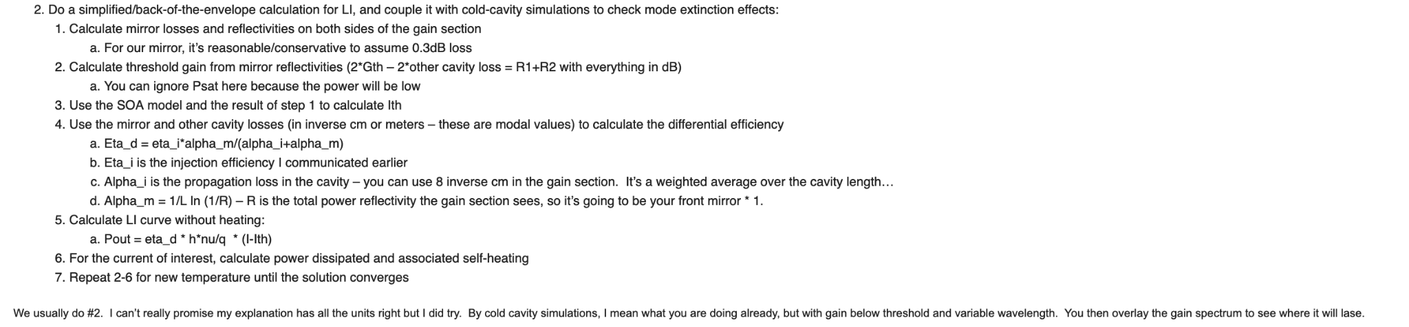
What SOA length to use (after openlight discussion)
Two approaches to picking SOA length (based on discussion with Molly):
Approach 1:
Start from openlight’s TRL design (1100um long SOA).
Calculate additional single-pass cavity losses
Increase SOA length to compensate at a rate of 1.67dB/100um
Approach 2:

Slide 19
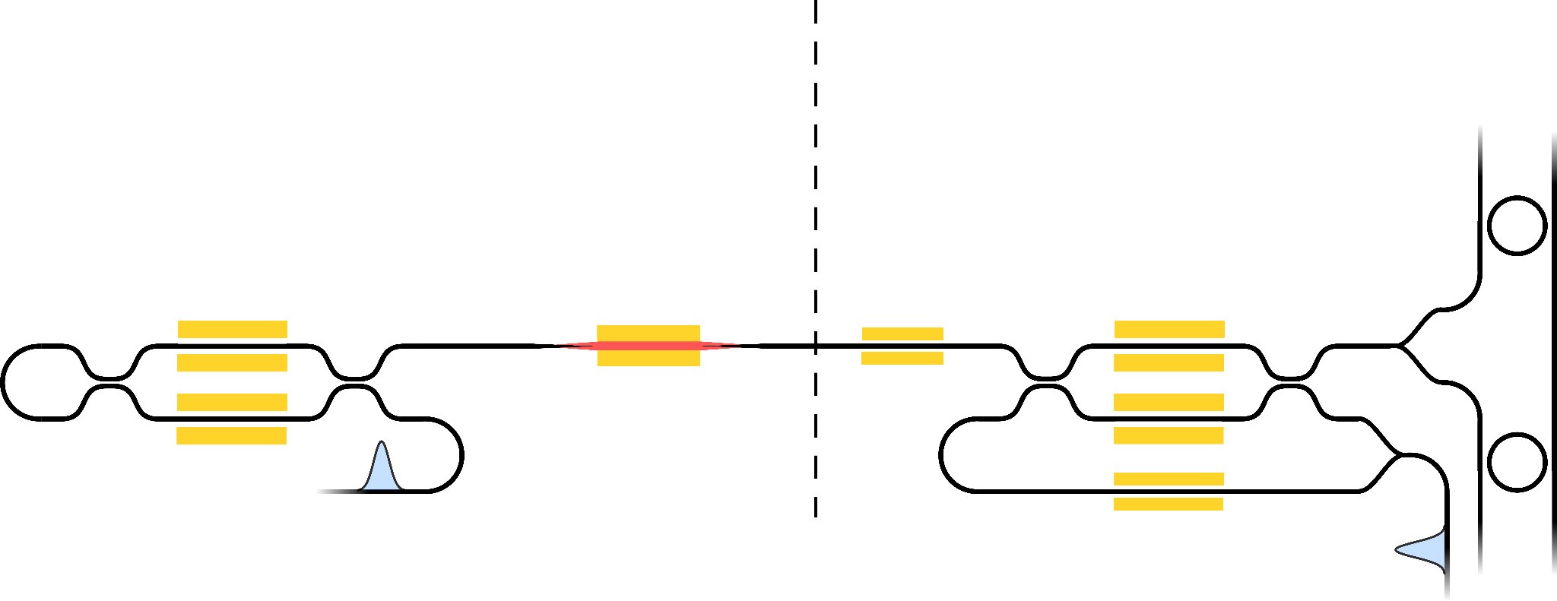
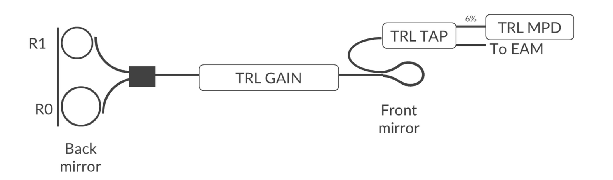
What SOA length to use, approach 1
0.17 dB assuming 60mW in cavity
0.085 dB each assuming 60mW in cavity
EC=1.5 dB
0.6 dB
Assume that losses from out coupling are equivalent for both systems
Δ_{rings}= 0.6 dB - 0.3 dB = 0.3 dB
Δ_{EC} = 2.0 dB
Δ_{XPS+YJ} = 0.35 dB
Δ_{sagnac} = 0.09 dB
~500um extra silicon to leave EPI on PH18DA -> Δ_{Si} = 0.5mm * 1dB/cm = 0.05dB
~1mm of extra SiN on 45CLO ->Δ_{SiN} = 0.03dB
Total additional gain needed:
Δ_{rings}/2 + Δ_{EC} + Δ_{XPS+YJ} + Δ_{sagnac}/2 + Δ_{Si} + Δ_{SiN} = 2.62 dB
For reference: additional loss in ECL w/AWG + Ring laser was 1.8dB. Guidance from openlight was to increase length by 200um to 1300um to provide an additional 3.3dB gain
nit_y_junction 0.087 dB
Sagnac reflector loss limited by Y-junction which is ~90mdB
SOA transitions + propagation losses accounted for in both designs
79% Power out-coupling
Spec from ECL w/ AWG+ Ring DR
0.3 dB

Slide 20
What SOA length to use, approach 2
Step 1 + 2: Use single-pass cavity losses to calculate threshold gain
Assume 60% of light out-coupled at MZI -> Loss_{out-coupling}= 3.98 dB
Using values from previous slide:
Loss_{sagnac}/2 + Loss_{EC} + Loss_{XPS+YJ} + Loss_{rings}/2 + Loss_{Si} + Loss_{SiN} + Loss_{out-coupling}= 6.76 dB
G_{th} = 4.74 (linear units)
Code for approach 2 located here

Slide 21
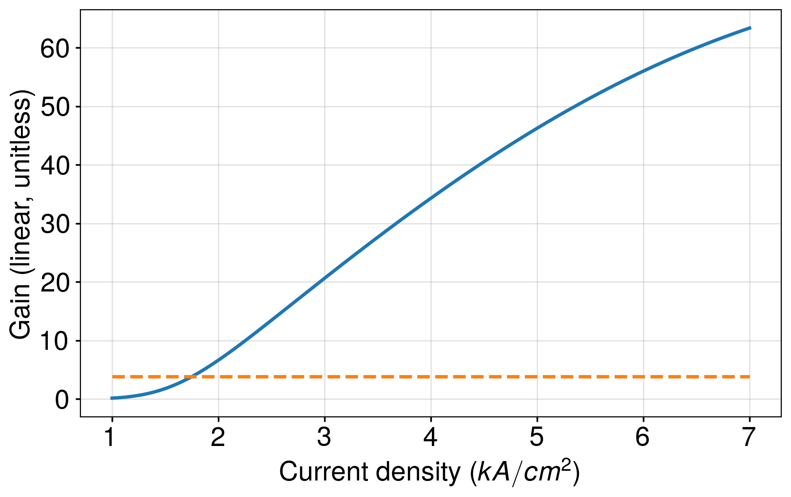
What SOA length to use, approach 2
Step 3: Use the SOA model + result from previous step to calculate I_{th}
Sweep current density, on SOA model.
Calculate g₀ (unsaturated gain).
Find intersection point, J_{th}
Example plot on the right is for a 1100um
long soa at T_{amb} = 70℃, 𝜆=1310nm
Convert J_{th} to I_{th} using:

Slide 22
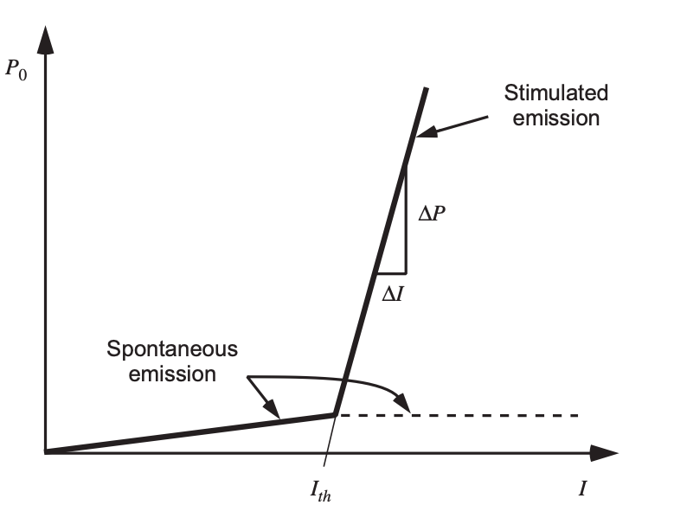
What SOA length to use, approach 2
Step 4: Calculate differential efficiency using cavity losses
Differential efficiency (η_{d}) is the change in output power for a change in current above threshold. It’s calculated as:
η_{d} = η_{i} 𝛼_{m}/(𝛼_{i} + 𝛼_{m})
where η_{i} = 0.7 close to 70℃
𝛼_{m}/(𝛼_{i} + 𝛼_{m}) -> “Fraction of photons lost to out-coupling”
η_{d}=ΔP/ΔI

Slide 23
What SOA length to use, approach 2
Step 4: Calculate differential efficiency using cavity losses
Loss to out-coupling = 3.98dB
𝛼_{m} = -ln(1-P_{couple})/L_{longitudinal} ~ 230 (1/m) assuming L_{longitudinal}= 4mm
𝛼_{i} = 𝛼_{SOA} + 𝛼_{other_components}
= 800(1/m) +ln(G_{th})/L_{longitudinal}
At L_{soa} = 1100um 𝛼_{m}/(𝛼_{i} + 𝛼_{m}) = 0.192
η_{d} = 0.135
η_{d}=ΔP/ΔI

Slide 24
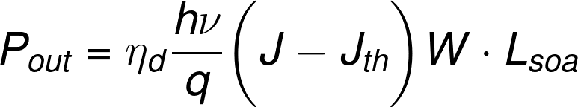
What SOA length to use, approach 2
Step 5: Calculate LI curve without self-heating
Take the results so far, plug into below equation. Convert current density (J) to current (I) based on context
Notes:
P_{out} = \eta_{d}\frac{h\nu}{q}\bigg(J - J_{th} \bigg) W \cdot L_{soa}

Slide 25
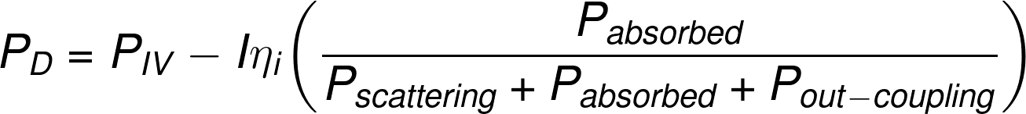
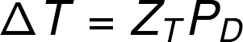
What SOA length to use, approach 2
Step 6: Calculate power dissipated for current of interest
From Coldren page 79:
P_{Dissipated} = P_{IV} - P_{optical,out}
The above equation is suitable for DFB’s, VCSELs. We need to modify this equation to have all radiated photons not contribute to heat (shown right).
Assumption here:
Passive component losses + out-coupling losses don’t contribute to SOA self-heating, SOA losses are absorbative, contribute to heating.
Thermal-resistance (Z_{T}) of SOA junction is 102C/W at 1100um length, scales as 1/Length
Notes:
P_{D} = P_{IV} - I\eta_{i}\bigg(\frac{\alpha_{passive} + \alpha_{coupling}}{\alpha_{passive} + \alpha_{coupling} + \alpha_{SOA}} \bigg)
P_{D} = P_{IV} - I\eta_{i}\bigg(\frac{P_{absorbed}}{P_{scattering} + P_{absorbed} + P_{out-coupling}} \bigg)

Slide 26
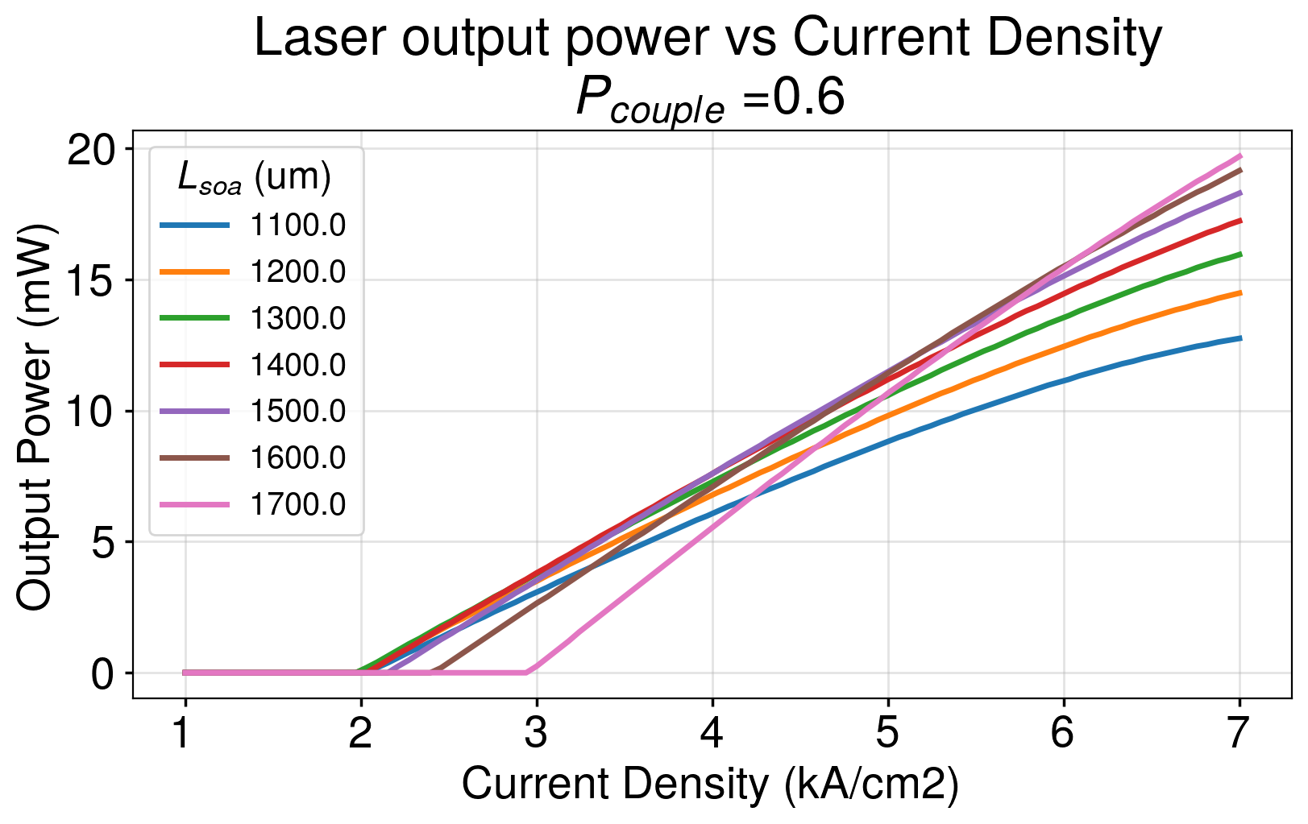
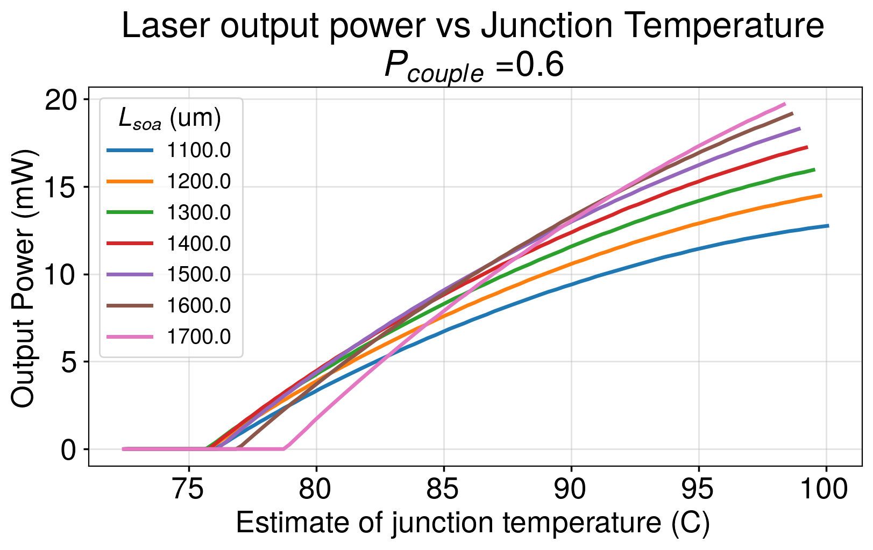
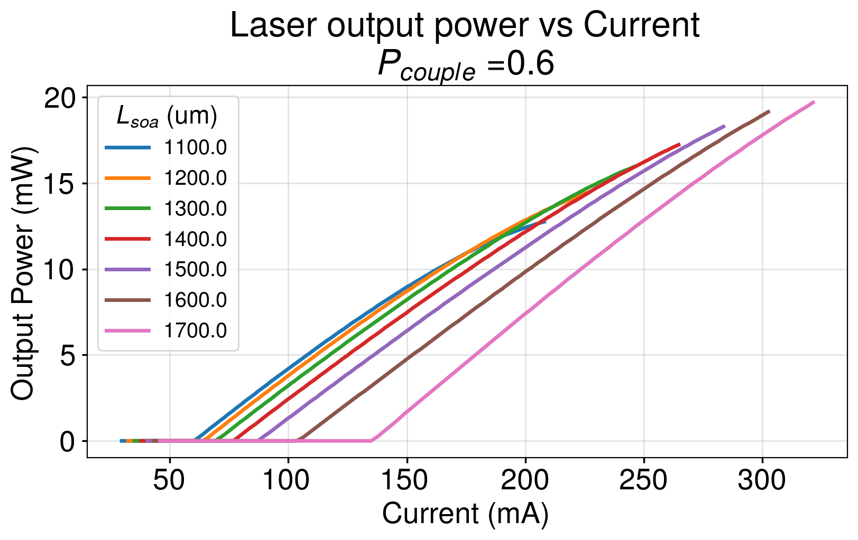
What SOA length to use, approach 2, P_{couple}= 0.6
Step 7 : Run simulation repeatedly, updating P_{D} and junction temperature (SOA temp) on each iteration until convergence

Slide 27
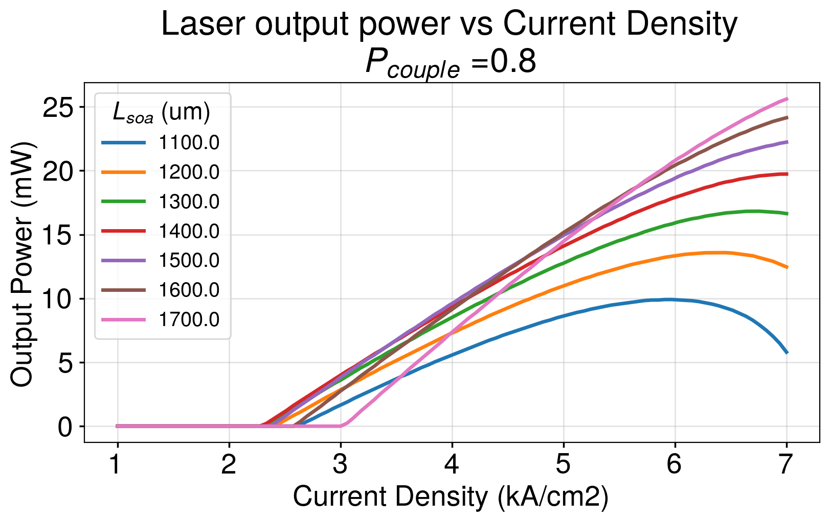
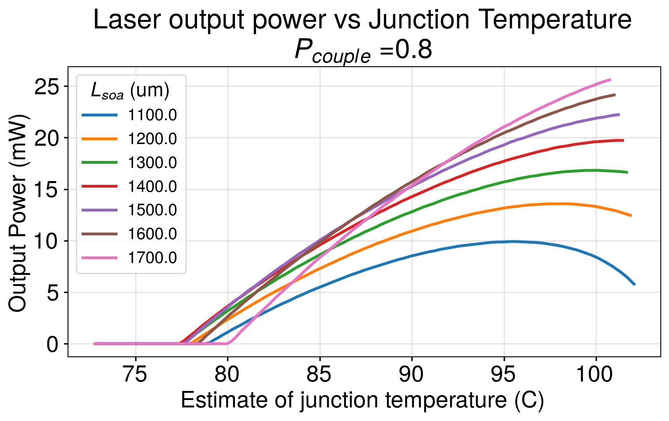
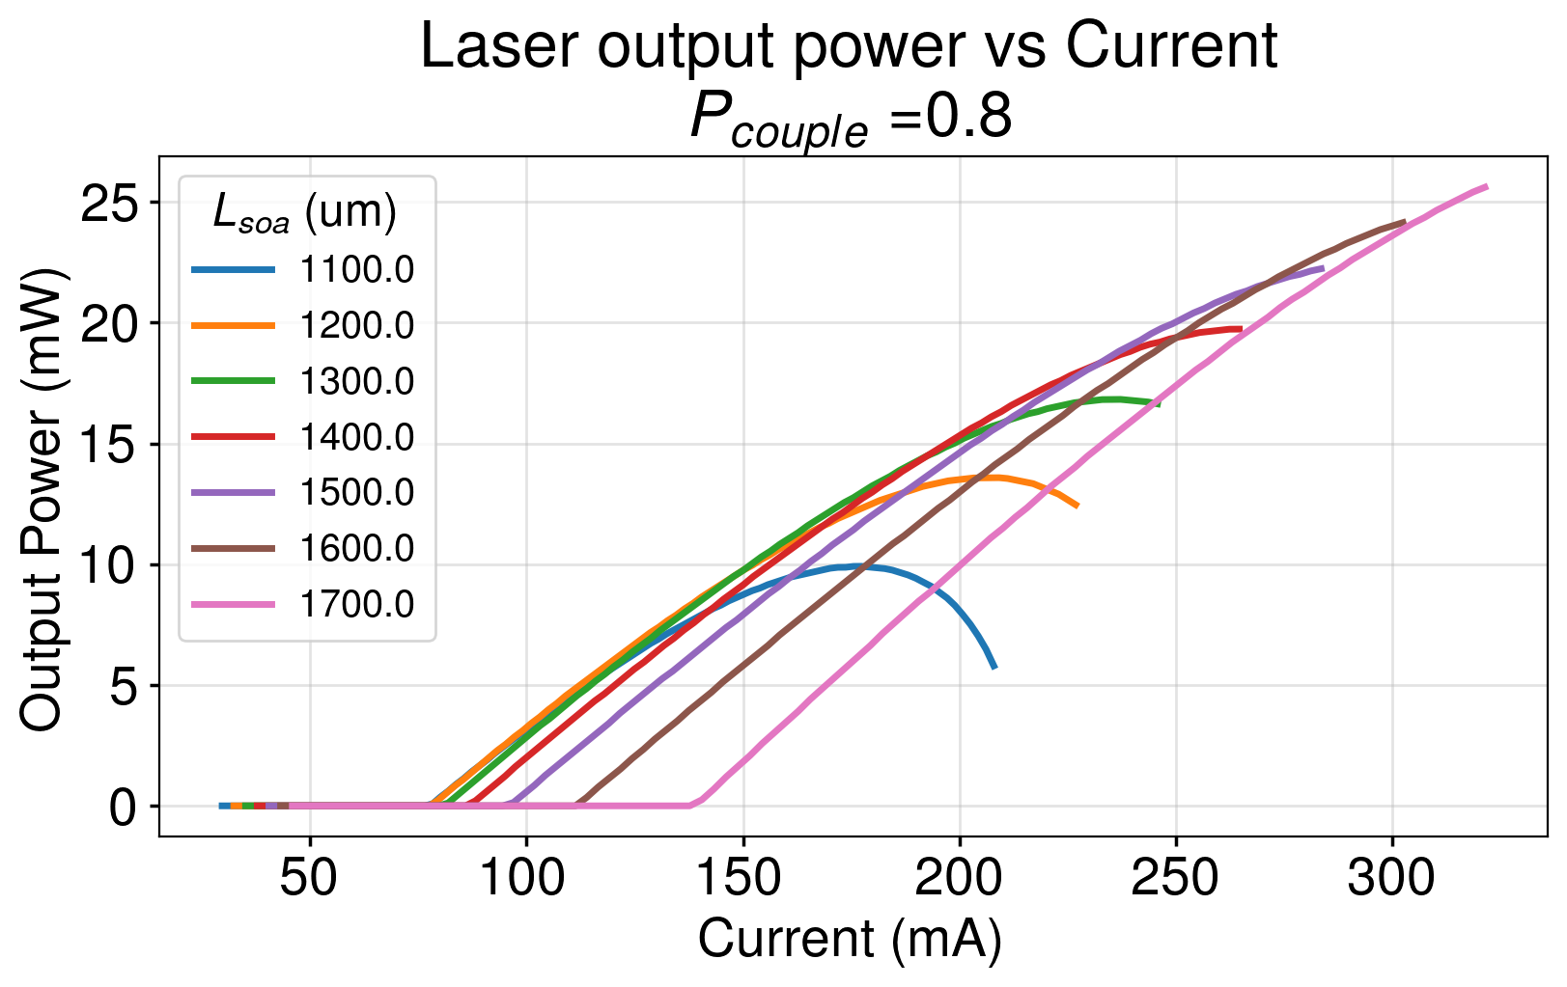
What SOA length to use, approach 2, P_{couple}= 0.8
Step 7 : Run simulation repeatedly, updating P_{D} and junction temperature (SOA temp) on each iteration until convergence

Slide 28
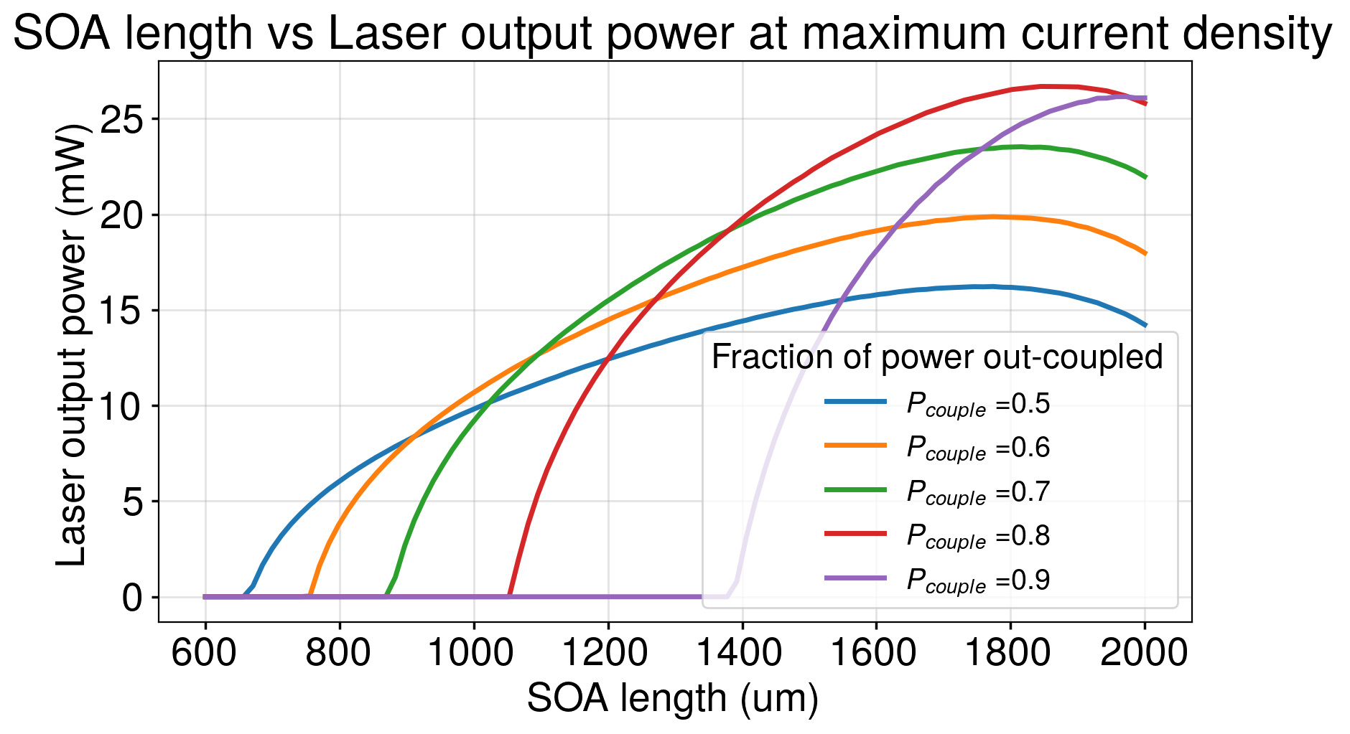
What SOA length to use

Slide 29
Alex S’s concerns on approach 2
The temperature update doesn’t make sense to me, the SOA model was generated from measured data, which would had self heating embedded inside of it. The calculated junction temperature should not add back to ambient temperature.

Slide 30
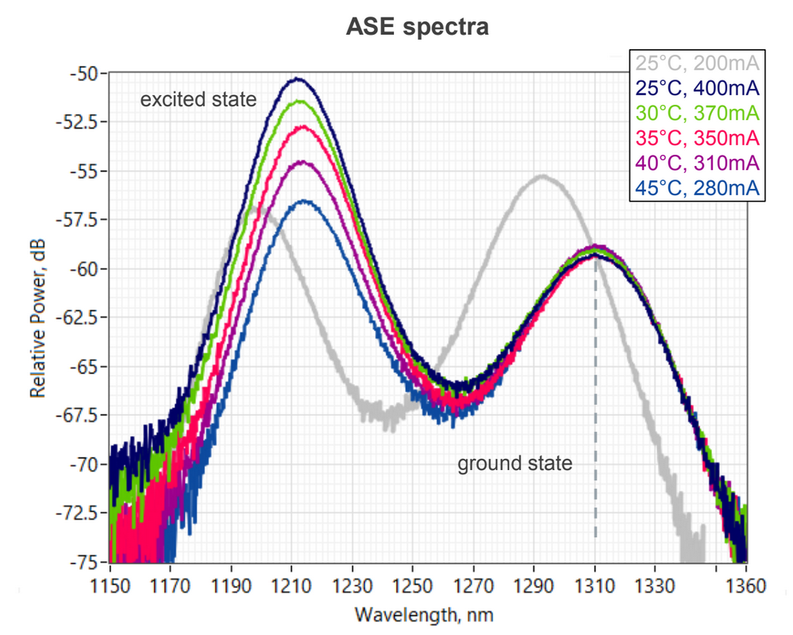
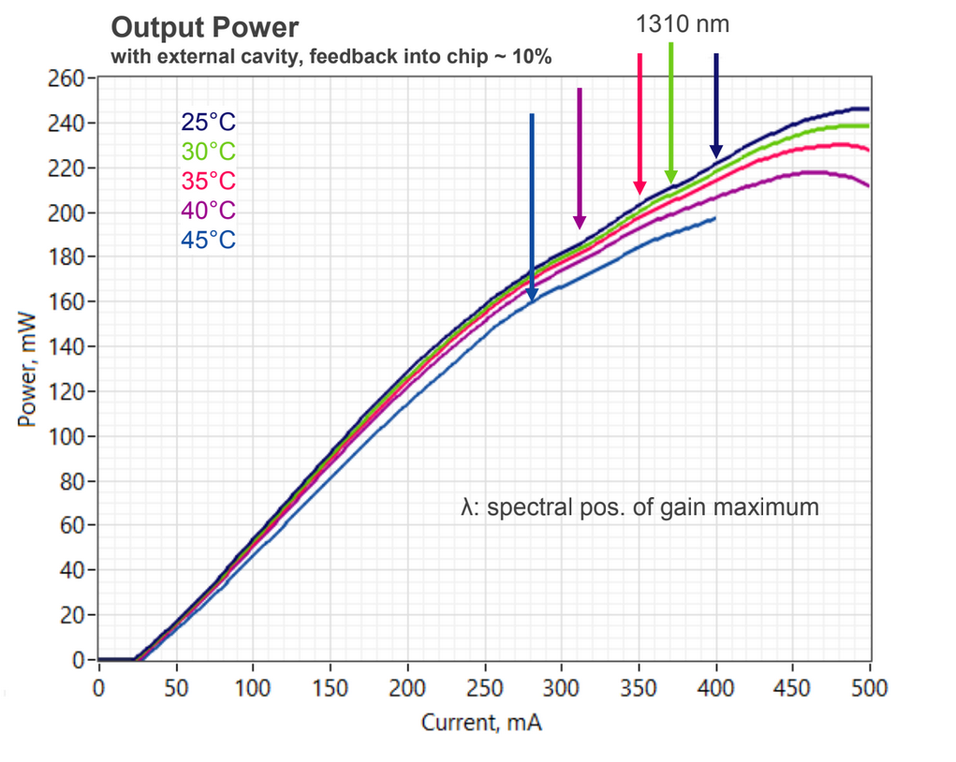
Innolume RSOA 1210nm gain peak supression
When RSOA pumped strongly the quantum dot at ~1210nm has more gain than 1310nm QD.
Practical operation of this device will be at 100mA-200mA pump current.
During practical operation we need ~6dB of extra loss
Talking to David H, wavelength dependence of our SiN ring directional coupler will lead to ~3dB extra loss at 1210nm
~6dB reduction to have 3dB SMSR

Slide 31
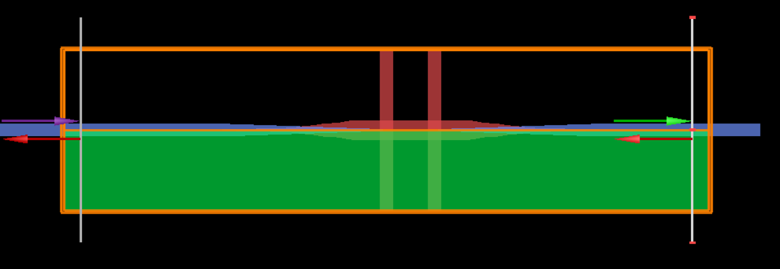
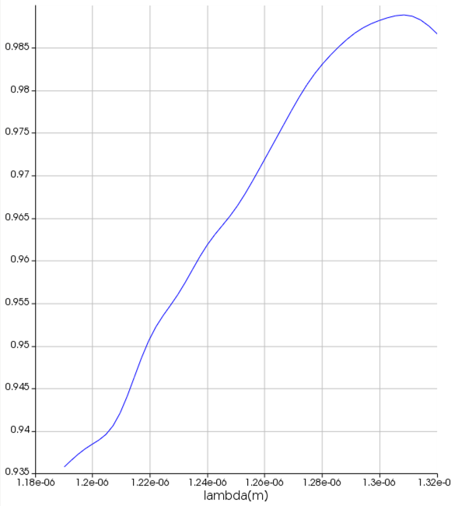
XPS Bandwidth Simulation
To check how much XPS attenuates ~1200nm light I did a 3D FDTD sim of XPS’s insertion loss
Setup: Import optimized dual XPS gds.
Check input/output modes reach 1E-12 at simulation edge
Mesh 5
Run for 2000fs (~4x larger than TOF)
Add symmetry along y-axis
Transmission shown right
1310nm IL matches value Shashank gave me
In our ECL architecture XPS gives an addition 0.5dB of rejection to QD gain at 1210nm
0.988 @ 1310nm = 52mdB
0.942 @ 1210nm = 260mdB

Slide 32
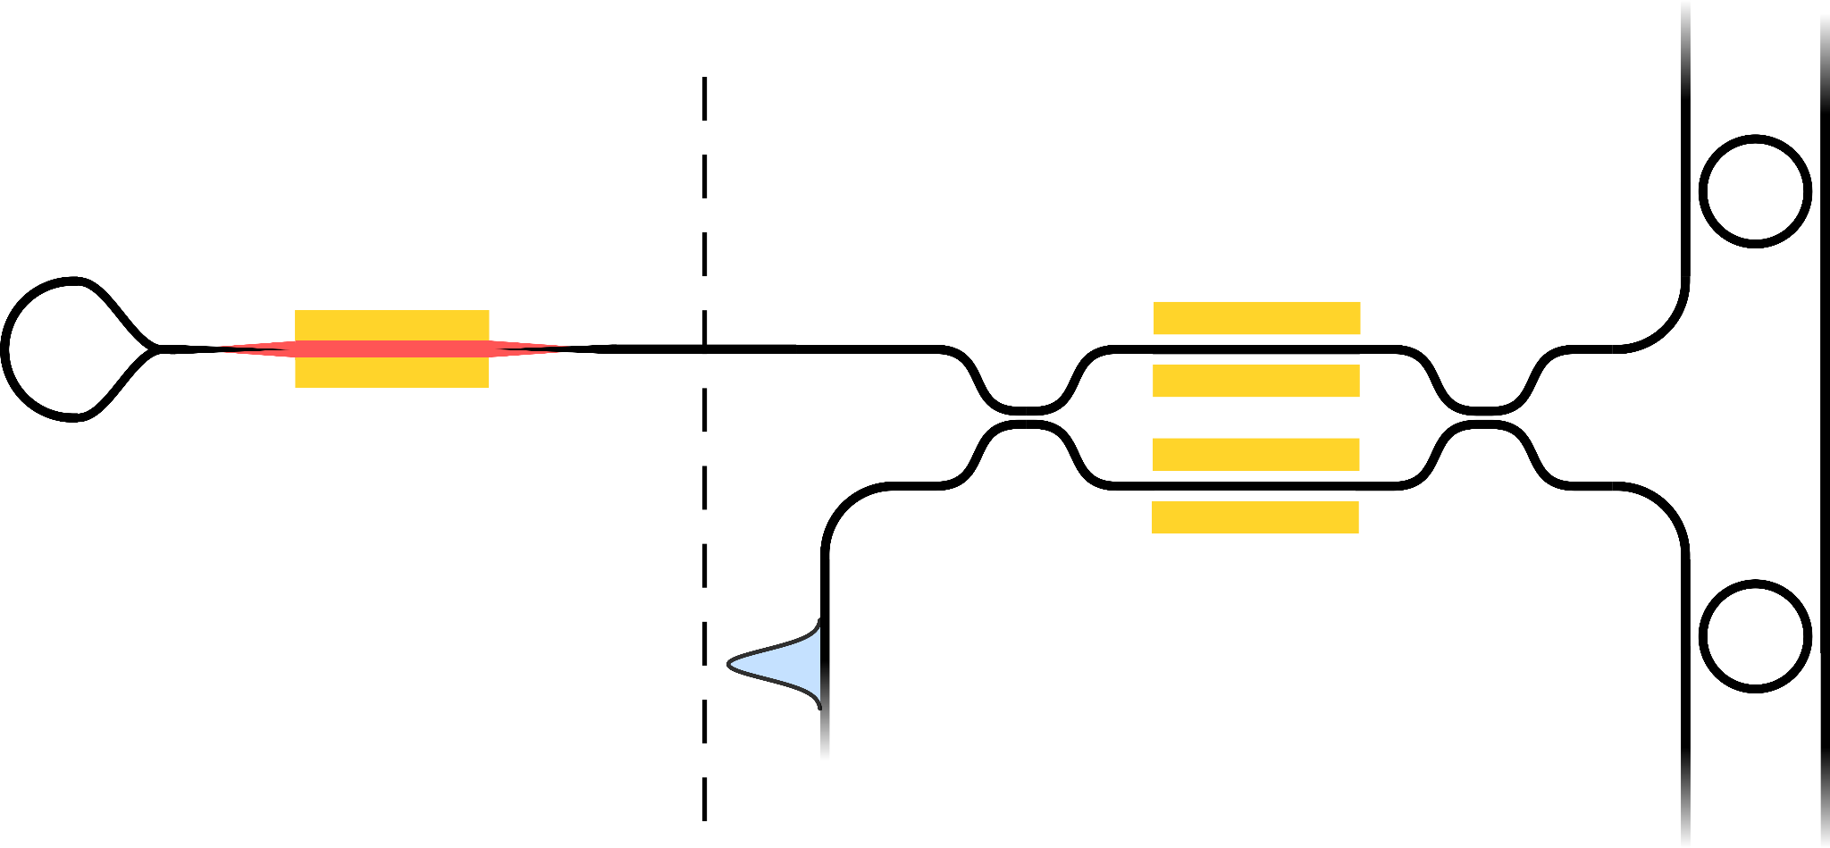
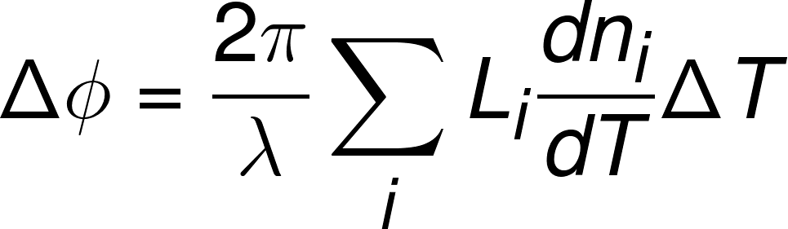
Amount of phase shift to stabilize laser mode
Openlight’s guidance is:
Passive devices have dn/dT = 2.05 * 10⁻⁴ 1/C
The gain medium has dn/dT = 3.0 * 10⁻⁴ 1/C
GF’s guidance is:
SiN has dn/dT = 2.189 * 10⁻⁵ 1/C
Silicon in O-band has dn/dT = 1.9 * 10⁻⁴ 1/C
I want to know over our operating temperature range of 10-80 -> ΔT = 70 what is

Slide 33
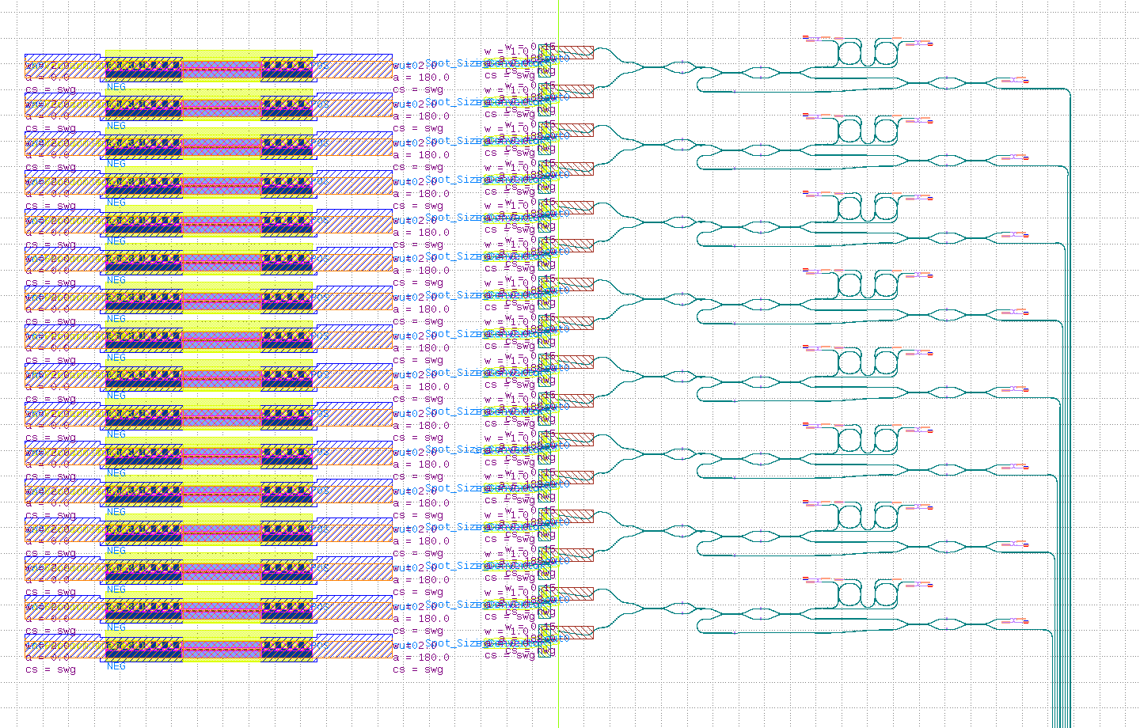
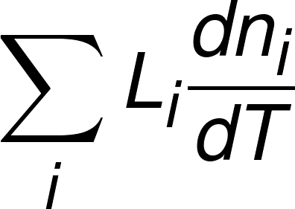
Amount of phase shift to stabilize laser mode
Measuring from the updraft - pinion mockup (shown right) I’m making the following estimates:
The RSOA has ~750um of silicon outside of the gain region.
Assume the RSOA is 1700um long
The SSC is ~300um long of silicon
There is ~1200um of SiN outside of the rings
Expected loaded ring Q of 20k -> 13.8ps of propagation time -> 2.6mm of SiN propagation
= 8.08*10⁻⁷ meters -> 268 radians of phase shift over ambient temperature range
Device | dn/dT | Distance (L) | dn/dT*L (m)
OL Si outside RSOA | 2.05 * 10⁻⁴ | 0.75mm | 1.538 * 10⁻⁷
RSOA gain | 3.0 * 10⁻⁴ | 1.7mm | 5.1 * 10⁻⁷
OL SSC | 2.05 * 10⁻⁴ | 0.3mm | 6.15 * 10⁻⁸
45CLO SiN outside rings | 2.189 * 10⁻⁵ | 1.2mm | 2.62 * 10⁻⁸
45CLO SiN rings | 2.189 * 10⁻⁵ | 2.6mm | 5.69 * 10⁻⁸
Notes:
\Delta \phi = \frac{2\pi}{\lambda}\sum_{i}L_{i}\frac{dn_{i}}{dT}\Delta T

Slide 34
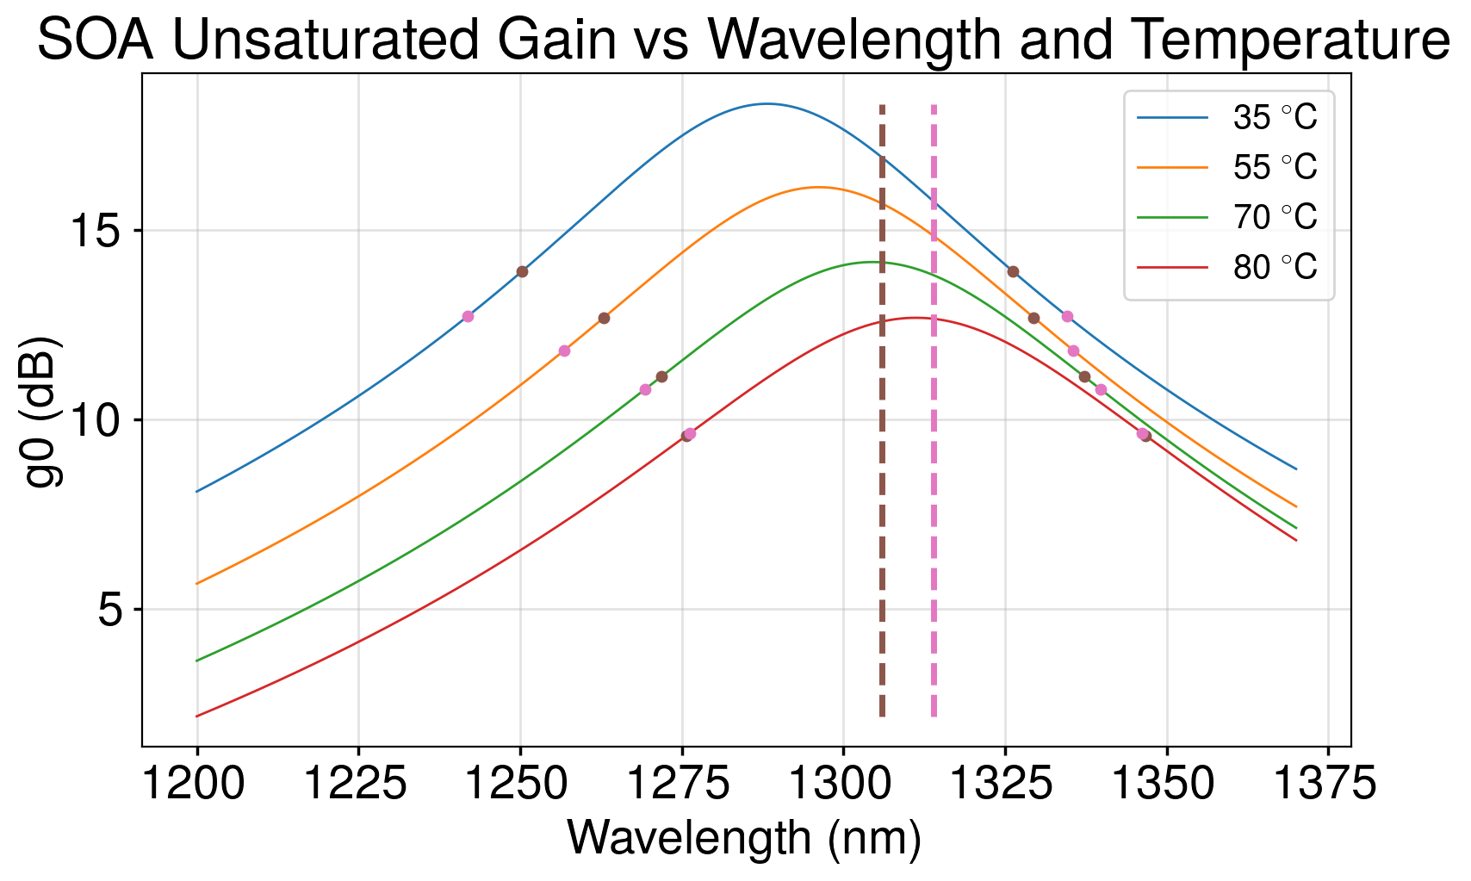
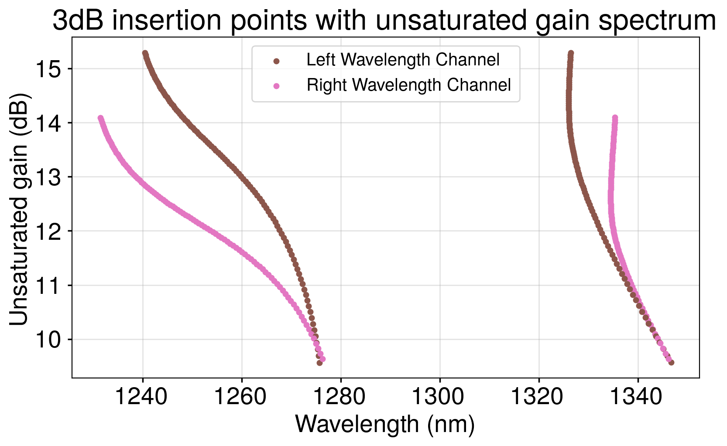
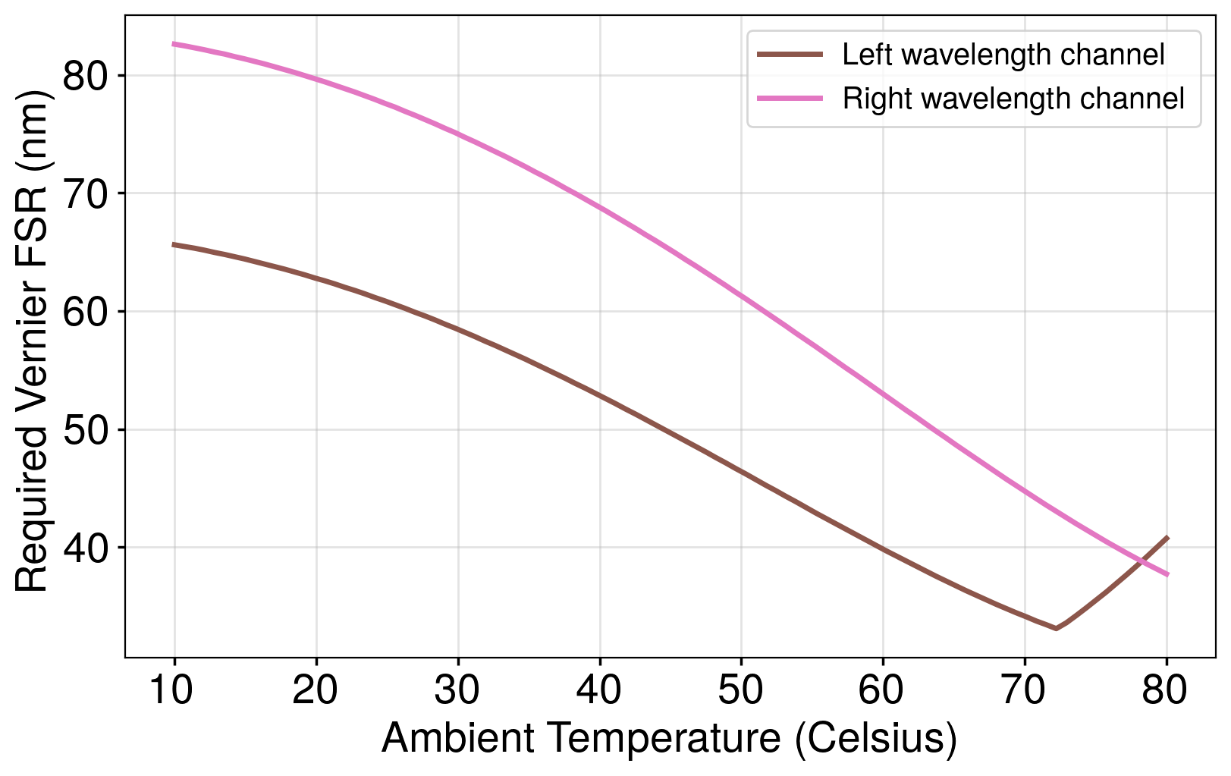
Vernier FSR Spec vs Temperature
Jessie asked me to look at how our Vernier FSR spec might change over temperature.
Here, I’m assuming a 900um long SOA, J=7kA/cm²
Brown and pink vertical lines represent left and right most wavelength channels:
1310nm -3.5*200GHz
1310nm +3.5*200GHz
Brown and pink dots are the wavelength where the gain spectrum is 3dB lower
I added a design to meet 80nm Vernier FSR
Required Vernier FSR
Sweep temperature from 10℃ to 80℃ with 100 points

Slide 35
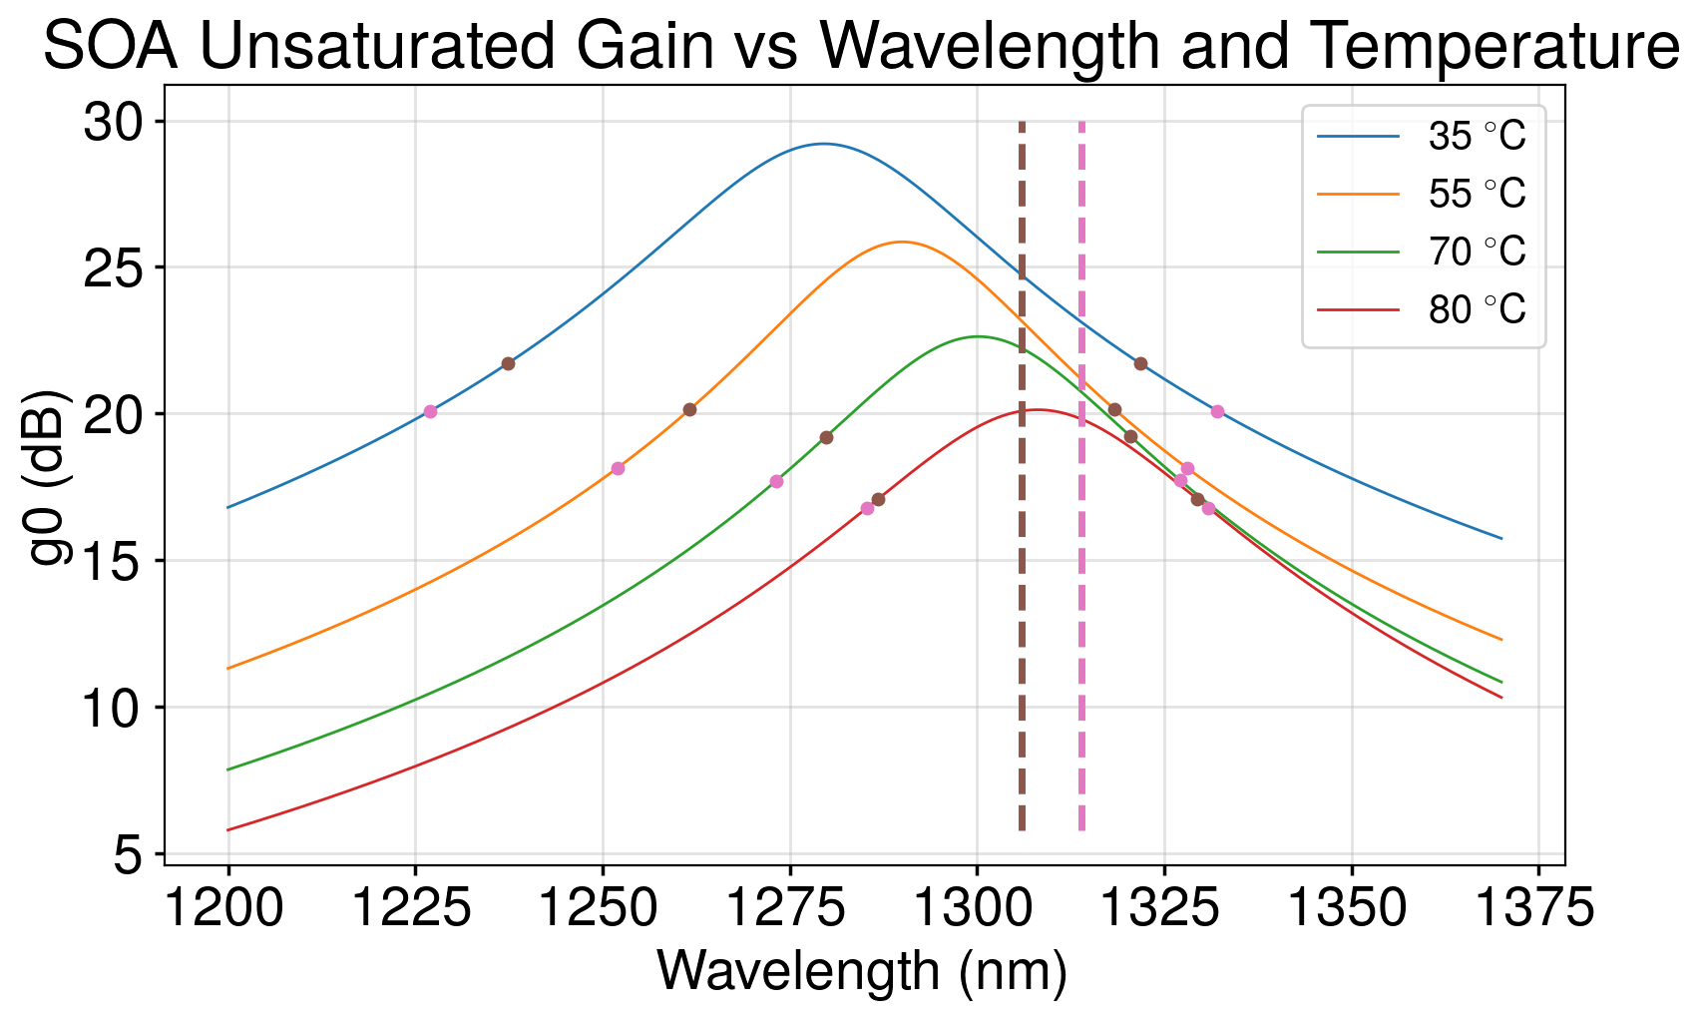
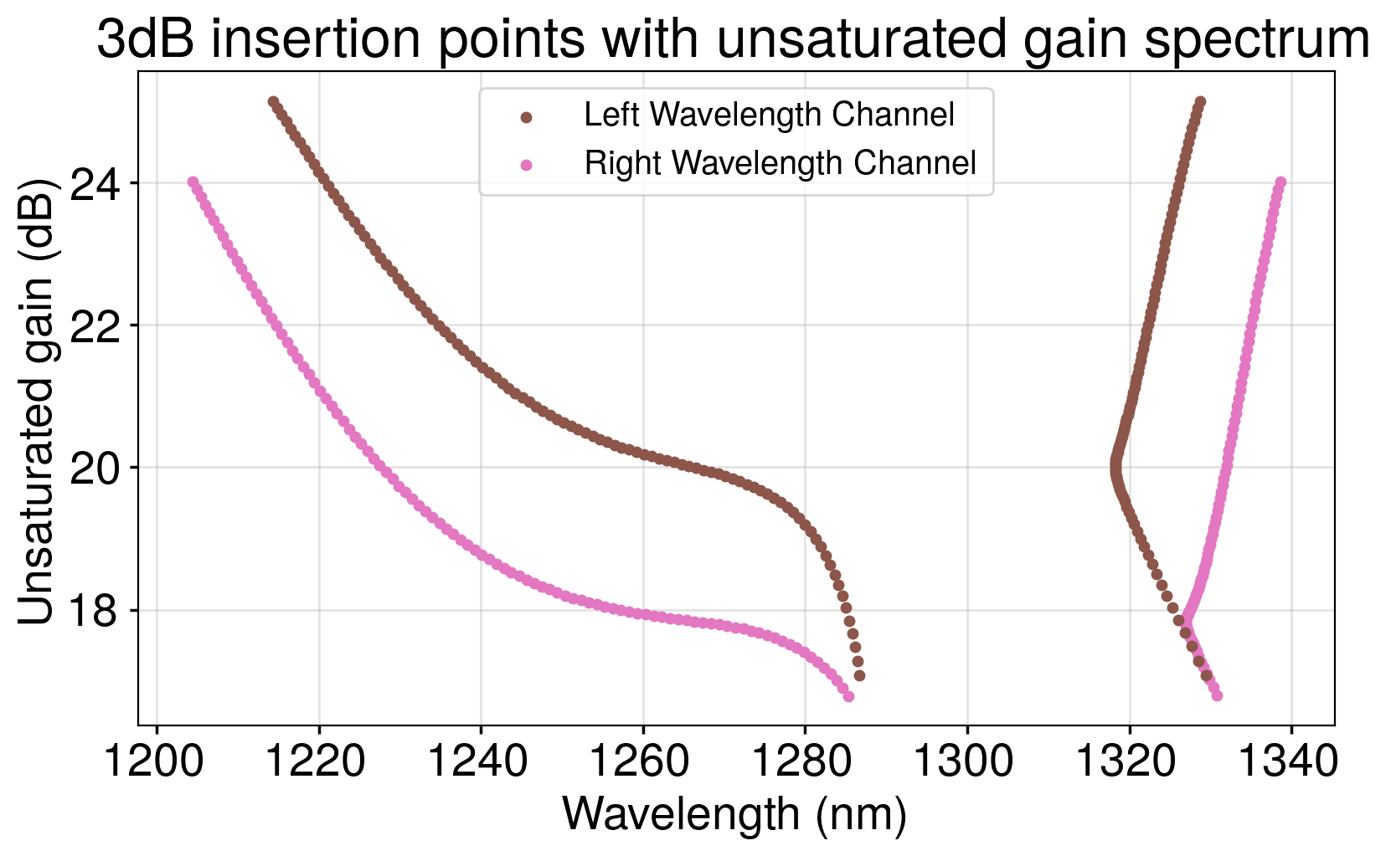

Vernier FSR Spec vs Temperature
Here, I’m assuming a 1300um long SOA, J=7kA/cm²
Brown and pink dots are the wavelength where the gain spectrum is 3dB lower
Sweep temperature from 10℃ to 80℃ with 100 points

Slide 36
Subcomponents
Tower + Openlight die
45CLO die
Model of an SOA
Model of NLA + NLA inside of rings
* From “Widely-Tunable Ring-Resonator Semiconductor Lasers”, Bowers

Slide 37

Waveguide with NLA in Cadence
I created a simple model of NLA in verilogA
Run forward euler on nonlinear ODE. Starting condition to calculate attenuation is the sum of forward and backward wave powers

Slide 38

Waveguide with NLA in Cadence
The model in chamber matches our python models/fits perfectly.

Slide 39
Ring Resonator with NLA

Slide 40

Ring Resonator with NLA in Chamber
Fork CRR model.
Change two things:
Make it single ring
Reference a custom version of the crr phase shifter which includes NLA

Slide 41



Effect of Nonlinear Absorption on Ring
Vary field coupling (𝜅) and laser power in bus waveguide (P_{laser}=10uW,100uW,1mW).
Higher laser power increases loss, decreases linewidth. At weakest couplings transmission can be greatly reduced.
𝜅_{bus}=𝜅_{drop}=0.03
𝜅_{bus}=𝜅_{drop}=0.1
𝜅_{bus}=𝜅_{drop}=0.3
Drop Port Transmission (dB)
Wavelength (um)
Wavelength (um)
Wavelength (um)
Q=1310n/6pm~218k
FSR=9.7nm
Finesse=FSR/FWHM=1616
Q=1310n/33pm~37k
FSR=9.7nm
Finesse=FSR/FWHM=293
Q=1310n/285pm~4.6k
FSR=9.7nm
Finesse=FSR/FWHM=34

Slide 42

Power build up in the ring
Optical Power Buildup
Power build up in a cavity is:
Finesse/𝜋
For the Finesse on prior slides the power build up should be:
𝜅=0.03 -> 514
𝜅=0.1 -> 93.2
𝜅=0.3 -> 10.8
Measured values on resonance:
𝜅=0.03 -> 495.6
𝜅=0.1 -> 91.87
𝜅=0.3 -> 11.01
P_{cavity}/P_{laser}
Wavelength (um)

Slide 43


Vernier Effect With Two Rings
Two rings with radius r₁=5.218um, r₂=1.1*r₁. All 𝜅=0.1. Characterized at 1nW P_{laser}.
Expected Vernier FSR is 94nm from
Peak transmission is 850mdB

Slide 44


Vernier ring transmission vs Coupling
Field coupling vs vernier ring transmission tradeoff
Transmission (dB)
Field coupling (𝜅)
Field coupling (𝜅)

Slide 45


Vernier Ring vs Laser Power
For coupling values similar to the CRR (~0.5) we can support <10mW of light before significant loss

Slide 46
Simulating a laser in VerilogA

Slide 47


Simulation Testbench
Laser Output
SOA
Phase
Shifter
Tunable
Loss
Tunable Reflector
Tunable Reflector
Seed light source

Slide 48


Time domain behavior of SOA cavity
Send a 1ps wide pulse into cavity from seed laser, periodic oscillation + growth of the cavity power + laser power observed.
Laser Output
After SOA Forward Wave
After SOA Reverse Wave

Slide 49



Time domain behavior of SOA cavity
I create a pulsed laser that has a rep-rate matching the round-trip time in the cavity.
Laser Pulse Train
Power Inside Cavity
Power Leaving Cavity

Slide 50



Simulation Method Used
To make data extraction easy, we use a step function on the seed laser power.
The seed laser starts at 0W output power and steps to 1uW max power after 200fs.
After SOA Forward Wave
After SOA Reverse Wave
Seed laser power
SOA Gain (g)
Starts at g=g₀
Laser Output
Saturates at g=1.12=(R_{front}R_{back})^{-1/2}
T=50℃
J=7kA/cm²
L=400um
Loss=0dB
T_{front}=0.2
T_{back}=0.01

Slide 51


Laser Output Power vs Added Loss
Sweep front mirror reflectivity/transmission as well as sweep internal cavity loss.
Optimal reflectivity decreases with increasing loss.
Sweep T_{front}
T=50℃
J=7kA/cm²
L=400um
Sweep Loss
T_{back}=0.01

Slide 52


Adding in Vernier Rings + NLA
Tunable Reflector
Tunable Reflector
SOA
Phase
Shifter
Vernier Rings
Seed light source

Slide 53



NLA loss in Si CRR
Between one ring
5.218um radius CRR rings
All coupling coefficients are 0.5
Loss can reach up to ~10dB at 100mW input powers.
Idea: Engineer ring radius to decrease NLA
After both rings
Output Power (mW)
Input Power (mW)
loss = 28mdB @ P_{in}=0
Loss (dB)
Input Power (mW)

Slide 54


NLA loss in Si CRR at larger radius
20um radius CRR rings
NLA loss
All coupling coefficients are 0.5
Loss is larger than with 5.218um radius
Output Power (mW)
Input Power (mW)
Loss (dB)
Input Power (W)

Slide 55

NLA loss in Si CRR at larger radius
100mW
20um radius CRR rings
NLA loss
10mW
1mW
Output Power (W)
100uW
10uW
𝜅

Slide 56


NLA loss in Si CRR at smaller radius
2um radius CRR rings
Ignore extra bending loss
All coupling coefficients are 0.5
Output Power (mW)
Input Power (mW)
Loss (dB)
Input Power (W)

Slide 57

NLA loss in Si CRR at smaller radius
2um radius CRR rings
Ignore extra bending loss
100mW
10mW
1mW
Output Power (W)
100uW
10uW
𝜅

Slide 58

Laser Output Power with Vernier Rings
Sweep front mirror reflectivity/transmission as well as sweep internal cavity loss.
Optimal reflectivity decreases with increasing loss.
Laser Output Power (mW)
Sweep T_{front}
T_{front}
T=50℃
J=7kA/cm²
L=400um
R_{bot}=5.218um
R_{top}=1.1*R_{bot}
𝜅=0.5
T_{back}=0.01

Slide 59



Thinking about Solutions
EC = 1 dB
We don’t have enough gain to overcome NLA loss. Why not add an amplifier afterwards?
Adding two amplifiers in series doesn’t work well, gain saturation + NLA mean very small output power increases.
Output power can reach > 25mW at 2dB edge coupling loss. Risks for reliability, yield.
EC = 1.5 dB
EC = 2 dB
Laser Output Power (mW)
T_{front}
T=50℃
J=7kA/cm²
L=400um
Sweep T_{front}
R_{bot}=5.218um
R_{top}=1.1*R_{bot}
𝜅=0.5
T_{back}=0.01
Sweep EC

Slide 60

OpenLight Reference Laser Design
How has a reference tunable laser design (below).
The bottom image is a version of this design ported to 45SPCLO with a tunable front mirror and coherent combiner of forward + backward waves
Tower/OpenLight
GF 45SPCLO

Slide 61

OpenLight Reference Laser Design
Optimize the coherent combiner phase shifter to maximize output power
Laser Output Power (mW)
T=50℃
J=7kA/cm²
L=400um
T_{back}=0.01
P_{couple}= 0.9
R_{bot}=5.218um
R_{top}=1.1*R_{bot}
𝜅=0.5
Sweep Δ𝜑

Slide 62

OpenLight Reference Laser Design
Sweep output 2x2 switch coupler to maximize light
Laser Output Power (mW)
EC = 0 dB
EC = 1 dB
EC = 1.5 dB
EC = 2 dB
Sweep EC Loss
Fraction of light coupled out
T=50℃
J=7kA/cm²
L=400um
T_{back}=0.01
Sweep P_{couple}
R_{bot}=5.218um
R_{top}=1.1*R_{bot}
𝜅=0.5
Δ𝜑 = 133.6842 degrees

Slide 63
SMSR, Mode Hoping, Linewidth and RIN

Slide 64


SMSR
Side Mode Supression Ratio (SMSR) is the ratio between power in the main laser wavelength the highest sidemode that is excited.
We want this value to be at least 30dB
Not to be confused with Vernier sidemode supression
8dB Vernier sidemode supression
SMSR =
H. Guan et al, Optics Express 2018

Slide 65


Calculating SMSR
There are equations for SMSR in L. Coldren (see pages 139, 150 for derivation + example)
The same equations are also used here and here
Modal gain margin.
Difference in gain between lasing mode and sidemode (units 1/length)
Loss margin.
Difference in loss between lasing mode and sidemode (units 1/length)
Net modal gain for main mode
Notes:
SMSR = \frac{\Delta \alpha + \Delta g}{\delta_{G}} + 1 \approx \frac{\Delta \alpha}{\delta_{G}} + 1
\delta_{G} = \alpha_{m}(\lambda_{0}) + \alpha_{i} - \Gamma \cdot g(\lambda_{0})
\Delta \alpha = \alpha_{m}(\lambda_{1}) - \alpha_{m}(\lambda_{0})
\Delta g= \Gamma \cdot g(\lambda_{1}) - \Gamma \cdot g(\lambda_{0})

Slide 66



Calculating SMSR
After some math…
Mirror loss
Internal loss of 7.6 cm⁻¹
Lasing mode @ 1310nm has SMSR=1
Spontaneous emission factor
~10⁻⁴
Radiation efficiency
~80%
SOA current vs threshold current
Notes:
\delta_{G} = (\alpha_{i} + \alpha_{m})\beta_{sp}\eta_{r}\frac{I_{th}}{I - I_{th}}
\alpha_{m} = -\frac{1}{2 L_{soa}}\ln(R_{front}\cdot R_{back})

Slide 67


Relating Cavity SMSR to Laser SMSR
Using equations from previous two slides, I’m plotting the cavity SMSR (can represent either Vernier or Longitudinal) vs what Laser SMSR it gives.
Here, I’m assuming:
𝛽_{sp}=10⁻⁴
𝜂=0.8
𝛼_{i}=760 m⁻¹
L_{SOA}=1.1mm
I/I_{th}=3
Guidance from Openlight, use literature values for AlGaInAs
A big picture take away:
Beyond 3.05 dB cavity SMSR a 1dB increase in cavity SMSR gives <1 dB increase in laser SMSR.

Slide 68



Relating Vernier SMSR to Quality Factor
Ring transfer function is:
I want to know how far apart the first vernier resonances need to be to get sufficient side mode suppression
ΔFSR
FWHM
1/SMSR
Vernier SMSR (dB) | ΔFSR/FWHM_{single ring}
3 | 0.657
5 | 0.859
7.5 | 1.16
10 | 1.57

Slide 69


Relating Longitudinal SMSR to Quality Factor
ΔFSR_{longitudinal}
Ring transfer function is:
Quick sanity check
FWHM
1/SMSR
Longitudinal SMSR (dB) | ΔFSR_{longitudinal}/FWHM_{single ring}
3 | 0.321
5 | 0.441
7.5 | 0.585
10 | 0.753

Slide 70







Python Model of Laser Tradeoff Space
Use equations from W. Bogaerts ring resonator review paper
Assume equal drop and bus coupling.
Additional longitudinal length from ring mirrors added according to equations from Bowers
Longitudinal cavity modeled by equation from Wikipedia
Python classes found here

Slide 71
Pure SiN Vernier Mirror Laser

Slide 72

Pure SiN Vernier Mirror Laser
Design composed of only nitride
L_{SiN} = length of longitudinal cavity if material converted to silicon nitride and ignoring the extra “length” added by Vernier rings
Tower + Openlight die
45CLO die
L_{SiN}
Design notebook here

Slide 73

Ring Coupling Tradeoff Space. Design 1
Allowed coupling strengths in range
𝜅² = [0.056,0.07] @ L_{SiN}=4mm
Assume 68.8 dB/m nitride loss
Values comes from Dione max_curv 0.03 corner bend loss
Targeting 10dB Vernier and 10dB longitudinal SMSR
Loss > 0.6dB
Vernier SMSR tradeoff space
Longitudinal SMSR tradeoff space
Design notebook here

Slide 74



Pure SiN Vernier Mirror Laser Loss, L_{SiN} = 4mm. Design 1
This data created assuming
L_{SiN} = 4mm, n_{g}=1.98
R₁ = 40um, R₂=1.05*R₁ = 42um
𝜅² = 0.06
Transmission through Vernier rings: -0.564 dB
Ring Q ~ 18.6k, FSR = 3.45nm, Finesse = 49.2
Vernier SMSR (dB) = 13.6
Longitudinal SMSR (dB) = 10.6
Design notebook here

Slide 75



Pure SiN Vernier Mirror Laser Loss, L_{SiN} = 5mm. Design 1
This data created assuming
L_{SiN} = 5mm, n_{g}=1.98
R₁ = 40um, R₂=1.05*R₁ = 42um
𝜅² = 0.056
Transmission through Vernier rings: -0.605 dB
Ring Q ~ 20.0k, FSR = 3.45nm, Finesse = 52.7
Vernier SMSR (dB) = 14.4
Longitudinal SMSR (dB) = 9.68
Design notebook here

Slide 76


Pure SiN Vernier Mirror Laser Loss, L_{SiN} = 6mm. Design 1
This data created assuming
L_{SiN} = 6mm, n_{g}=1.98
R₁ = 40um, R₂=1.05*R₁ = 42um
𝜅² = 0.056
Transmission through Vernier rings: -0.605 dB
Ring Q ~ 20.0k, FSR = 3.45nm, Finesse = 52.7
Vernier SMSR (dB) = 14.1
Longitudinal SMSR (dB) = 8.55
Design notebook here

Slide 77


Matching Cadence Sims and Python. Design 1
R₁ = 40um, R₂=1.05*R₁ = 42um
𝜅² = 0.06
Transmission
Wavelength (um)

Slide 78


Cadence Laser Output Power. Design 1
Max output power 33.6mW at 𝜆=1310nm and P_{couple_switch}=0.523
Output power measured as sum of output y-junction inputs
Output Power (mW)
P_{couple_switch}

Slide 79


Power inside of nitride rings. Design 1
Add power monitors inside of rings during cadence sim. Rings tuned on resonance at 1310nm, phase of longitudinal cavity tuned to maximize output light
Forward and reverse propagating waves, 470mW of light inside ring when lasing

Slide 80


Thermal tuning power needed for vernier rings
Want to lase here
The worst-case tuning range for vernier rings is when:
Both rings come out of fab in-phase with each other, but the desired lasing wavelength is a bit less than 1 FSR away (common mode tuning)
The rings need to compensate for full temperature range (10℃-70℃) (common mode tuning)
For 40um ring radius (design 1), worst case change in temperature needed at the waveguide is 343℃,
P_{FSR} = 283mW -> total heater power in both rings ~687 mW assuming R_{therm} = 1000℃/W. Desmos calculator here.
Sanity checks for Si and SiN temperature
Temperature spec can be lowered by increasing ring radius, power would stay the same.
Temperature can be lowered through larger radius (motivating design 2 which has 60um radius -> 248 degree change worst case temperature).
Ring₁
Ring₂
~1 FSR
R_{therm} estimate from MRM scales by ratio of radii
Notes:
\Delta \phi = \frac{2\pi}{\lambda}\frac{dn}{dT}\Delta T \cdot 2\pi R
P_{worst \ case} = 2\cdot P_{FSR} + 2 \cdot P_{FSR} \cdot \frac{T_{range}}{T_{FSR}}

Slide 81
Estimating Laser Wall Plug Efficiency - Worst Case Scenario
Largest power consumption comes from SOA, SiN rings
Assuming Pure SiN rings:
P_{SOA} = 266mW
P_{SiN} = 687mW
P_{Laser} = 25mW
WPE = P_{Laser}/(P_{SiN} + 2*P_{SOA}) ~ 2.05%
Assuming SiN + XPS rings:
P_{SOA} = 266mW
P_{SiN+XPS rings} = 42.5mW
P_{Laser} = 25mW
WPE = P_{Laser}/(P_{SiN+XPS rings} + 2*P_{SOA}) ~ 4.35%
Note: This assumes both SOAs fully on, rings in worst-case power scenario.

Slide 82
Estimating Laser Wall Plug Efficiency - Average Case Scenario
Assume SiN rings have uniform random phase distribution, rings independent.
Average power needed is to tune half an FSR + 70 degree range.
Largest power consumption comes from SOA, SiN rings
Assuming Pure SiN rings:
P_{SOA} = 266mW
P_{SiN} = 403mW
P_{Laser} = 25mW
WPE = P_{Laser}/(P_{SiN} + P_{SOA}) ~ 3.73%
Assuming SiN + XPS rings:
P_{SOA} = 266mW
P_{SiN+XPS rings} = 25.5mW
P_{Laser} = 25mW
WPE = P_{Laser}/(P_{SiN+XPS rings} + P_{SOA}) ~ 8.57%
Note: This assumes only using one SOA on average, rings in average-case power scenario.

Slide 83

Ring Coupling Tradeoff Space. Design 2
Allowed coupling strengths in range
𝜅² = [0.084,0.105] @ L_{SiN}=4mm
𝜅² = [0.084] @ L_{SiN}=5mm
Assume 68.8 dB/m nitride loss
Values comes from Dione max_curv 0.03 corner bend loss
Targeting 10dB Vernier and 10dB longitudinal SMSR
Loss > 0.6dB
Vernier SMSR tradeoff space
Longitudinal SMSR tradeoff space
Design notebook here

Slide 84



Pure SiN Vernier Mirror Laser Loss, L_{SiN} = 4mm. Design 2
This data created assuming
L_{SiN} = 4mm, n_{g}=1.98
R₁ = 60um, R₂=1.05*R₁ = 63um
𝜅² = 0.09
Transmission through Vernier rings: -0.558 dB
Ring Q ~ 18.39k, FSR = 2.30nm, Finesse = 32.3
Vernier SMSR (dB) = 10.2
Longitudinal SMSR (dB) = 10.5
Design notebook here

Slide 85



Pure SiN Vernier Mirror Laser Loss, L_{SiN} = 5mm. Design 2
This data created assuming
L_{SiN} = 5mm, n_{g}=1.98
R₁ = 60um, R₂=1.05*R₁ = 63um
𝜅² = 0.084
Transmission through Vernier rings: -0.596 dB
Ring Q ~ 19.7k, FSR = 2.30nm, Finesse = 34.6
Vernier SMSR (dB) = 10.7
Longitudinal SMSR (dB) = 9.58
Design notebook here

Slide 86


Pure SiN Vernier Mirror Laser Loss, L_{SiN} = 6mm. Design 2
This data created assuming
L_{SiN} = 6mm, n_{g}=1.98
R₁ = 60um, R₂=1.05*R₁ = 63um
𝜅² = 0.084
Transmission through Vernier rings: -0.596 dB
Ring Q ~ 19.7k, FSR = 2.30nm, Finesse = 34.6
Vernier SMSR (dB) = 10.7
Longitudinal SMSR (dB) = 8.45
Design notebook here

Slide 87
Ring Coupling Tradeoff Space. Design 3
Motivation: At low ambient temperatures, gain spectrum is much broader resulting in higher required FSR spec
Goal: Redesign SiN ring with the following specs + tradeoffs:
~60um radius (see design 2, lowers heater temperature)
Double Vernier FSR (target 80-90nm)
Modest increase in insertion loss
Modest decrease in Vernier SMSR

Slide 88

Ring Coupling Tradeoff Space. Design 3
Allowed coupling strengths in range
𝜅² = [0.062,0.065] @ L_{SiN}=6mm
Assume 68.8 dB/m nitride loss
Values comes from Dione max_curv 0.03 corner bend loss
Targeting 7dB Vernier and 10dB longitudinal SMSR
Loss > 0.8dB
Vernier SMSR tradeoff space
Longitudinal SMSR tradeoff space
Design notebook here

Slide 89



Pure SiN Vernier Mirror Laser Loss, L_{SiN} = 6mm. Design 3
This data created assuming
L_{SiN} = 6mm, n_{g}=1.98
R₁ = 60um, R₂=1.025*R₁ = 61.5um
𝜅² = 0.063
Transmission through Vernier rings: -0.790 dB
Ring Q ~ 26.3k, FSR = 2.30nm, Finesse = 46.2
Vernier SMSR (dB) = 7.83
Longitudinal SMSR (dB) = 10.1
Design notebook here

Slide 90



FDTD Sims of SiN Ring FSR
Take SiN ring from Ayan / github
Add 800nm wide SiN ridge waveguides to route from FDTD ports to ring
Ring parameters: nit_race_track_ring__length_3p1__w1_0p8__w2_0p8__gap_0p6__radius_33p33__curvature_grad_0p002__st_wg_wd_0p8__st_wg_length_0p001__bus_taper_length_20p0
Using SiN material Philips, 300nm thick
Z min bc symmetry
Mesh 3 (46nm mesh size)
FDTD sim size (X,Y,Z)=(98,102,18)um
Sim sized to avoid field clipping to 1E-15

Slide 91


FDTD Sims of SiN Ring FSR: Results
Thru port transmission
Dips in spectrum at:
1307.37nm
1310.68nm
FSR = 3.31nm
Drop port transmission
FSR = 3.31nm

Slide 92
Pure Si Vernier Mirror Laser

Slide 93
Pure Si Vernier Mirror Laser
Design composed of silicon rings
Assume Si ring design comes from GF single ring CRR.
Components external to rings are nitride + silicon XPS where appropriate
L_{SiN} = length of longitudinal cavity if material converted to silicon nitride and ignoring the extra “length” added by Vernier rings
Tower + Openlight die
45CLO die
L_{SiN}
Design notebook here

Slide 94

Design guidelines
To help guide ring design:
Assume FSR_{longitudinal}=50pm. To get 3dB suppression:
FWHM_{single ring}> 155pm -> Q_{loaded}>8410
I made a testbench substituting the rings for ideal loss components and swept the loss on both rings to get laser output power vs single ring loss. Assumes 1.5dB edge coupler
2.07 dB ring loss allows for 25mW output power
Laser Output Power (mW)
P_{couple} sweep
Single ring loss (dB)

Slide 95

Design guidelines
Ring design tradeoff space at 10mW input power, k² power coupling on bus and drop ports
Vernier FSR comes from approximation (see Vernier SMSR slide for why this is a reasonable approximation)
Ring Radius (um) | FSR (nm) | Single ring loss (dB), k²=0.1 | Q, k²=0.1 | Vernier FSR estimate, k²=0.10 (nm) | Single ring loss (dB), k²=0.15 | Q, k²=0.15 | Vernier FSR estimate, k²=0.15 (nm) | Single ring loss (dB), k²=0.2 | Q, k²=0.2 | Vernier FSR estimate, k²=0.2 (nm)
3 | 13.565 | -3.014 | 1896 | 279.90 | -1.455 | 1407 | 211.21 | -0.841 | 1136 | 173.14
5.218 | 9.147 | -3.747 | 2528 | 170.60 | -1.998 | 1911 | 131.20 | -1.239 | 1573 | 109.61
10 | 5.373 | -4.676 | 3782 | 88.73 | -2.746 | 2898 | 69.25 | -1.838 | 2427 | 58.87
20 | 2.885 | -5.748 | 6105 | 41.67 | -3.671 | 4717 | 32.85 | -2.613 | 3996 | 28.27
30 | 1.972 | -6.407 | 8204 | 26.32 | -4.26 | 6355 | 20.83 | -3.159 | 5407 | 18.02
40 | 1.498 | -6.98 | 10150 | 18.87 | -4.705 | 7785 | 14.83 | -3.565 | 6714 | 12.99
50 | 1.207 | -7.28 | 12000 | 14.56 | -5.062 | 9312 | 11.57 | -3.896 | 7948 | 10.05

Slide 96

Estimating Power At Different Points in Design for NLA
0.665 coupling
2.8mW
8.4mW
10.4mW
38.6mW
12.8mW
r₁=5.218um
r₂=1.2*r₁
𝜅²=0.25 on bus and drop
g=5.25
P_{laser}=31.5mW

Slide 97
What about adding more filters? Three rings
Analysis here
Assume Q is low enough that
We would need max ring loss to be 4.17dB / 3 = 1.39dB for three rings
Even if Q is lower from coupling, we will still have ~60pm longitudinal FSR from extra photon lifetime added by third ring
Required Q per ring drops to ~5.5k
Ring Radius (um) | FSR (nm) | Single ring loss (dB), k²=0.1 | Q, k²=0.1 | Vernier FSR estimate, k²=0.10 (nm) | Single ring loss (dB), k²=0.15 | Q, k²=0.15 | Vernier FSR estimate, k²=0.15 (nm) | Single ring loss (dB), k²=0.2 | Q, k²=0.2 | Vernier FSR estimate, k²=0.2 (nm) | Single ring loss (dB), k²=0.3 | Q, k²=0.3 | Vernier FSR estimate, k²=0.3 (nm)
3 | 13.565 | -3.014 | 1896 | 279.90 | -1.455 | 1407 | 211.21 | -0.841 | 1136 | 173.14 | -0.329 | 774 | 122.29
5.218 | 9.147 | -3.747 | 2528 | 170.60 | -1.998 | 1911 | 131.20 | -1.239 | 1573 | 109.61 | -0.531 | 1107 | 79.85
10 | 5.373 | -4.676 | 3782 | 88.73 | -2.746 | 2898 | 69.25 | -1.838 | 2427 | 58.87 | -0.884 | 1770 | 44.39
20 | 2.885 | -5.748 | 6105 | 41.67 | -3.671 | 4717 | 32.85 | -2.613 | 3996 | 28.27 | -1.429 | 3004 | 21.97
30 | 1.972 | -6.407 | 8204 | 26.32 | -4.26 | 6355 | 20.83 | -3.159 | 5407 | 18.02 | -1.83 | 4118 | 14.19
40 | 1.498 | -6.98 | 10150 | 18.87 | -4.705 | 7785 | 14.83 | -3.565 | 6714 | 12.99 | -2.155 | 5150 | 10.31
50 | 1.207 | -7.28 | 12000 | 14.56 | -5.062 | 9312 | 11.57 | -3.896 | 7948 | 10.05 | -2.428 | 6125 | 8.02
Could be potential here at higher coupling…

Slide 98
What about adding more filters? Four rings
Analysis here
Assume Q is low enough that
We would need max ring loss to be 4.17dB / 4 = 1.04dB for four rings
Assume ~60pm longitudinal FSR
Required Q per ring should be ~4750
Ring Radius (um) | FSR (nm) | Single ring loss (dB), k²=0.2 | Q, k²=0.2 | Vernier FSR estimate, k²=0.2 (nm) | Single ring loss (dB), k²=0.3 | Q, k²=0.3 | Vernier FSR estimate, k²=0.3 (nm) | Single ring loss (dB), k²=0.4 | Q, k²=0.4 | Vernier FSR estimate, k²=0.4 (nm)
3 | 13.565 | -0.841 | 1136 | 173.14 | -0.329 | 774 | 122.29 | -0.157 | 552 | 91.11
5.218 | 9.147 | -1.239 | 1573 | 109.61 | -0.531 | 1107 | 79.85 | -0.263 | 803 | 60.43
10 | 5.373 | -1.838 | 2427 | 58.87 | -0.884 | 1770 | 44.39 | -0.468 | 1316 | 34.38
20 | 2.885 | -2.613 | 3996 | 28.27 | -1.429 | 3004 | 21.97 | -0.823 | 2300 | 17.50
30 | 1.972 | -3.159 | 5407 | 18.02 | -1.83 | 4118 | 14.19 | -1.112 | 3201 | 11.47
40 | 1.498 | -3.565 | 6714 | 12.99 | -2.155 | 5150 | 10.31 | -1.358 | 4042 | 8.42
50 | 1.207 | -3.896 | 7948 | 10.05 | -2.428 | 6125 | 8.02 | -1.574 | 4838 | 6.59

Slide 99
Silicon Nitride + XPS Ring

Slide 100


SiN + XPS Ring
Ring composed of ideal waveguide with tunable loss, length. XPS as well as ideal directional couplers
Waveguide elements emulate a bend through:
Length = pi/2 * pPar(“length”)

Slide 101
SiN + XPS Design Tradeoff Space
Bounds are same as derived for Si Vernier Mirror Laser slide:
Q > 8410
Single ring loss < -2.07 dB
Ring Radius (um) | FSR (nm) | Single ring loss (dB), k²=0.1 | Q, k²=0.1 | Vernier FSR estimate, k²=0.10 (nm) | Single ring loss (dB), k²=0.15 | Q, k²=0.15 | Vernier FSR estimate, k²=0.15 (nm) | Single ring loss (dB), k²=0.2 | Q, k²=0.2 | Vernier FSR estimate, k²=0.2 (nm) | Single ring loss (dB), k²=0.3 | Q, k²=0.3 | Vernier FSR estimate, k²=0.3 (nm)
30 | 4.598 | -2.862 | 9459 | 157.26 | -1.683 | 7317 | 122.69 | -1.077 | 5854 | 99.08 | -0.538 | 3969 | 68.65
40 | 3.449 | -2.872 | 11820 | 110.75 | -1.692 | 8722 | 82.63 | -1.085 | 6978 | 66.80 | -0.543 | 4732 | 46.41
50 | 2.759 | -2.882 | 13130 | 79.05 | -1.702 | 10120 | 61.56 | -1.093 | 8127 | 49.98 | -0.549 | 5493 | 34.67
75 | 1.839 | -2.908 | 17610 | 47.31 | -1.724 | 13620 | 37.01 | -1.113 | 10900 | 29.99 | -0.564 | 7392 | 20.93
100 | 1.379 | -2.934 | 22120 | 33.51 | -1.747 | 17100 | 26.22 | -1.133 | 13690 | 21.26 | -0.58 | 9286 | 14.87
𝜅² between 15% and 20% trades off insertion loss vs filtering.

Slide 102


Zooming in on specific 𝜅² values. Design 1
Assume 1.5dB edge coupler loss R₁=40um, R₂=43um
Current density J=7kA/cm²
L_{soa}=440um
Temperature = 70C for SOA
Laser Output Power (mW)
Ring coupling 𝜅² in
[0.15,0.16,0.17,0.18,0.19,0.2]
𝜅²

Slide 103



Zooming in on specific 𝜅² values. Design 1
𝜅² must be < 0.165 for sufficient Vernier SMSR
Transmission
Wavelength
Longitudinal SMSR (dB) @10mW
Vernier SMSR (dB) @10mW
𝜅²
𝜅²

Slide 104


Zooming in on specific 𝜅² values. Design 1
Vernier mirror insertion loss (dB) @ 10mW input
Single ring quality factor (1,000’s)
𝜅²
𝜅²

Slide 105

Zooming in on specific 𝜅² values. Design 2
Assume 1.5dB edge coupler loss R₁=50um, R₂=53.75um
Current density J=7kA/cm²
L_{soa}=440um
Temperature = 70C for SOA
Laser Output Power (mW)
Ring coupling 𝜅² in
[0.15,0.16,0.17,0.18,0.19,0.2]
𝜅²

Slide 106
Zooming in on specific 𝜅² values. Design 2
𝜅² must be < 0.165 for sufficient Vernier SMSR
Transmission
Wavelength
Longitudinal SMSR (dB) @10mW
Vernier SMSR (dB) @10mW
𝜅²
𝜅²

Slide 107
Zooming in on specific 𝜅² values. Design 2
Vernier mirror insertion loss (dB) @ 10mW input
Single ring quality factor (1,000’s)
𝜅²
𝜅²

Slide 108


FDTD Sims of SiN + XPS Ring FSR
Take SiN + XPS ring from Ayan / github
Add 800nm wide SiN ridge waveguides to route from FDTD ports to ring
Ring parameters: nit_race_track_ring_with_XPS__length_3p1__w1_0p8__w2_0p8__gap_0p6__radius_33p33__curvature_grad_0p002__st_wg_wd_0p8__st_wg_length_10p0__bus_taper_length_20p0
Using SiN material Philips, 300nm thick
Si material Palik, 160nm thick
25nm spacer oxide between SiN and Si
No symmetry
Mesh 2 (37nm mesh size)
FDTD sim size (X,Y,Z)=(98,126,18)um
Sim sized to avoid field clipping to 1E-15

Slide 109


FDTD Sims of SiN + XPS Ring FSR: Results
Thru port transmission
Dips in spectrum at:
1307.37nm
1309.88nm
FSR = 2.51nm
Drop port transmission
FSR = 2.51nm

Slide 110
Silicon Nitride + XPS Laser Mux

Slide 111
SiN + XPS Ring IL vs FWHM Tradeoff
Input power to ring is 25mW

Slide 112
SiN + XPS Design Tradeoff Space
Bounds are same as derived for Si Vernier Mirror Laser slide:
Q > 8410
Single ring loss < -2.07 dB
Ring Radius (um) | FSR (nm) | Single ring loss (dB), k²=0.1 | Q, k²=0.1 | Vernier FSR estimate, k²=0.10 (nm) | Single ring loss (dB), k²=0.15 | Q, k²=0.15 | Vernier FSR estimate, k²=0.15 (nm) | Single ring loss (dB), k²=0.2 | Q, k²=0.2 | Vernier FSR estimate, k²=0.2 (nm) | Single ring loss (dB), k²=0.3 | Q, k²=0.3 | Vernier FSR estimate, k²=0.3 (nm)
30 | 4.598 | -2.862 | 9459 | 157.26 | -1.683 | 7317 | 122.69 | -1.077 | 5854 | 99.08 | -0.538 | 3969 | 68.65
40 | 3.449 | -2.872 | 11820 | 110.75 | -1.692 | 8722 | 82.63 | -1.085 | 6978 | 66.80 | -0.543 | 4732 | 46.41
50 | 2.759 | -2.882 | 13130 | 79.05 | -1.702 | 10120 | 61.56 | -1.093 | 8127 | 49.98 | -0.549 | 5493 | 34.67
75 | 1.839 | -2.908 | 17610 | 47.31 | -1.724 | 13620 | 37.01 | -1.113 | 10900 | 29.99 | -0.564 | 7392 | 20.93
100 | 1.379 | -2.934 | 22120 | 33.51 | -1.747 | 17100 | 26.22 | -1.133 | 13690 | 21.26 | -0.58 | 9286 | 14.87
𝜅² between 15% and 20% trades off insertion loss vs filtering.

Slide 113
Silicon Nitride + Si Bend Ring

Slide 114

SiN + Si bend
Custom Si + SiN bend decreases bend radius at the potential cost of NLA
Also may give some increase in thermal tuning efficiency compared to pure SiN
How good does this device need to be to make a useful ring?

Slide 115
Filter Architectures + Simulation Methods + Assumptions
Two configurations I am considering:
Simulation uses model of add-drop ring with equal bus + drop coupling.
Assumptions:
No NLA
Longitudinal cavity is 4mm of SiN external to rings
r₁
r₂
r₂
r₁
Vernier Mirror
Vernier Sagnac

Slide 116
Criteria for good device
A filter is suitable for us if:
The longitudinal cavity SMSR > 3 db
Loss through filter < -1.8 dB
Vernier FSR > 40nm
Vernier SMSR > 3 dB

Slide 117


12.0um Radii, n_{g}=2.265

Slide 118


15.0um Radii, n_{g}=2.265

Slide 119


17.5um Radii, n_{g}=2.265

Slide 120


20.0um Radii, n_{g}=2.265

Slide 121


12.0um Radii, n_{g}=2.765

Slide 122


15.0um Radii, n_{g}=2.765

Slide 123


17.5um Radii, n_{g}=2.765

Slide 124


20.0um Radii, n_{g}=2.765

Slide 125
Supplementary

Slide 126


Nonlinear Absorption Process Contributions
Four loss sources considered:
Propagation loss (𝜅₁)
Two photon absorption (adds to 𝜅₂)
Surface-state absorption (adds to 𝜅₂)
Two-photon induced free-carrier absorption (𝜅₃)
Where power over distance from NLA is calculated as:

Slide 127
Parameters for designing a Vernier Laser
Ring coupling
Radius
Vernier SMSR
Vernier Filter Q
Ring losses
Laser SMSR
NLA
Longitudinal SMSR
Vernier FSR
Finesse
Longitudinal Cavity Length
SOA Gain Bandwidth
Packaging
Output switch transmissivity
Losses
XPS
Mode-hopping
Laser Reflection Tolerance
Y-junction
Internal reflections
Component reflections
Thermal stability/ambient temperature
Edge-coupler
SOA P_{sat}
Laser Output Power
Losses

Slide 128
A table of the excess phase values to get Si vernier rings on resonance
Data taken at 50 degrees C
Radius | Bottom Ring Phase | Top Ring Phase
5.218um | 1.043 | 1.942
20um | 1.183 | -1.676
2um | 1.771 | -2.287

Slide 129
A table of the excess phase values to get SiN vernier rings on resonance
Data taken at 50 degrees C
Radius | Bottom Ring Phase | Top Ring Phase
25um | 173.96 | 7.22
40um | -3.03 | 2.159

Slide 130
Python Model

Slide 131

Python Simulation Method
Cadence simulations with NLA are slow because they are transient times which solve forward euler per timestep (sweeps of parameters can take 2-3 hours)
I created a simple python script for simulating SOA inside of two mirrors (shown below)
T=50℃
J=7kA/cm²
L=400um
Sweep Loss
T_{front}=0.2
T_{back}=0.01

Slide 132

Python Simulation Method: How does it work?
Run iterative algorithm, starting with seed light and sending it through the laser cavity repeatedly until the value converges
Find the code here inside of Alex_SOA_analysis.ipynb

Slide 133


Python Simulation Method
Working on effect of NLA on laser power
Needs some more work. I need to play with how reflected wave is handed for NLA in the CRR on each pass.

Slide 134

Some proof that this is a laser
Consider the system below. To have lasing the round trip gain must be greater than round trip loss in the cavity.
In the extreme loss case, the max SOA gain (g₀) must balance the mirror and propagation losses (T_{back},T_{front},L_{prop}) through the equation:
g₀²L_{prop}²T_{front}T_{back}>1
g₀²L_{prop}²T_{front}T_{back}=1
Limited by simulation termination condition
g
T=50℃
J=7kA/cm²
L=400um
Sweep Loss
T_{front}=0.5
T_{back}=0.5

Slide 135
Good papers reference
Some papers I reference often that I keep needing to find:
Bowers tutorial paper
“How to design a tunable laser” paper from M. Gioannini group
This NLA paper has some discussion + derivation on SMSR

Slide 136
Sanity Checking Laser Design

Slide 137

OpenLight Reference Laser Design: Making Sense of This Performance
Here, I’m checking power at a few locations to understand why this performs well.
All of these slides will be assuming optimally tuned values for output power (coupling, phase, resonance)
~3dB loss going through both rings. Value makes sense from previous slides NLA vernier ring measurementes.
We have 10mW of light in both arms after y-junction. ~20mW entering rings gives 3dB loss from referenced slide.
P_{fwd}=10.2 mW
P_{rev} = 5.5 mW

Slide 138

OpenLight Reference Laser Design: Making Sense of This Performance
We can calculate that the amount of loss seenby forward and backward wave in top ring are the same:
6.65 mW / 10mW = 5.5mW/8.44mW
P_{rev} = 8.44 mW
P_{fwd}= 6.65 mW

Slide 139

OpenLight Reference Laser Design: Making Sense of This Performance
We can calculate that the amount of loss seen by forward and backward wave in top ring are the same:
P_{rev} = 10.2 mW
P_{fwd}= 5.5 mW

Slide 140

OpenLight Reference Laser Design: Making Sense of This Performance
Here, forward wave is almost 2x power after MMI (some intrinsic loss in model)
We again see ~3dB NLA loss of the two rings
P_{fwd}= 20.85 mW
P_{rev}= 10.77 mW

Slide 141
Synopsys OptSim Models + Components

Slide 142

SOA Parameters
There seems to be some model of ASE/noise in here…

Slide 143

Tunable Ring Laser Parameters
F

Slide 144
Mapping euler bends to circular bends
Euler bend radius (um) | max_curv of Euler bend | Effective radius of circular bend (um) | Bend loss (estimate, mdB) | Propagation loss (dB/m)
50 | 0.02 | 61 | 3.5 | 36.5
40 | 0.025 | 49 | 4 | 52.0
30 | 0.033 | 41.2 | 4.5 | 69.5
20 | 0.05 | 35.9 | 13.56 | 240
10 | 0.1 | 35.4 | N/A | N/A
Loss data from Dione measurements, Credit to Ayan for Euler -> Circular bend mapping

